Slide 1
淺談傳統資產及虛擬資產
2025 年 10 月 15 日（星期三）

Slide 2
講者
倪智承先生 , CFA
(Wisely Ngai, CFA)
香港特許金融分析師學會
執行董事

Slide 3
簡介傳統資產
掌握投資基礎知識
可帶來長遠的裨益

Slide 4
目錄
投資者的類型和特徵
  影響投資者需求的因素
投資工具簡介
  股本證券（股票）簡介
  債務證券（債券）簡介
  比較股本和債務證券
  另類投資簡介
  私募股權投資簡介
風險管理
  投資風險
  資產配置與投資組合建構
  被動和主動投資管理
Notes:
Successful Active Management
Success in active management requires being better at assessing potential investments.
Factors that may contribute to success in active management include
access to better information,
ability to respond quickly, and
costs of exploiting a mispricing that are less than the mispricing.
In many markets, regulators require that that security information be made available to all market participants at the same time.
Most research shows that active management does not consistently outperform the market over long time periods.
Notes:
The research needed for valuation and trading are both costly, so the mispricing must be sufficiently large to exploit it.
Discussion questions:
Why do investment managers pursue active management strategies if, on average, they do not outperform the market on a risk-adjusted basis?
In an informationally inefficient market, how can someone outperform the market on a risk-adjusted basis?

Slide 5
投資者的類型和特徵

Slide 6
投資者類型
客戶在財務資源、目標、個性、財務專業知識等方面有所不同。
這些差異導致了不同的投資需求、所需的服務和投資的適當性。
投資者之間最基本的區別是個人投資者和機構投資者之間的區別。
  個人投資者為其個人帳戶買賣有價證券或授權買賣有價證券。
  機構投資者為自己或他人持有和管理資產組合。
Notes:
Types of Investors
Clients differ in terms of financial resources, objectives, personalities, financial expertise, and so on.
These differences result in different investment needs, services required, and appropriateness of investments.
The most basic distinction among investors is that between individual and institutional investors.
Individual investors buy or sell securities or authorize the trade of securities for their personal accounts.
Institutional investors hold and manage portfolios of assets for themselves or others.
Notes:
Elderly clients, for example, may be most concerned about estate planning. Outliving assets would be problematic.
Services also may differ because of interests of clients and expertise.
Discussion questions:
How might the expertise differ between individual and institutional clients?
What type of services might an individual investor need?
NOTE: Terms that are bolded indicate glossary terms. Graded components of the Investment Foundations Certificate assess both learner understanding of terminology as well as the principles conveyed.

Slide 7
個人投資者
散戶投資者可以指所有投資者，也可以指資源有限的投資者。
高淨值和超高淨值投資者擁有大量的可投資資產。
個人投資者的服務取決於可投資資產。
  專業公司可能需要最少的可投資資產，並且可能會提供更多的個人關注。
  專注於散戶投資者的公司可能會使用更多的自動化和更標準化的服務。
個人投資者的投資知識廣泛，監管機構可能會限制投資以保護投資者。
Notes:
Individual Investors
Retail investors may refer to all investors or refer to those with modest resources.
High-net-worth and ultra-high-net-worth investors have a large amount of investable assets.
Services for individual investors depend on investable assets.
Specialist firms may require a minimum of investable assets and may offer more personal attention.
Firms focusing on retail investors may use more automation and more standardised services.
The investment knowledge of individual investors is wide-ranging, and regulators may restrict investments to protect the investor.
Notes:
Some investment firms may require a minimum fee, making them uneconomical for investors with smaller amounts of investable assets.
Firms that focus on high-net-worth clients may have fewer clients, but provide more services, including separately managed accounts,
Some investments, such as hedge funds, may be restricted to accredited, experienced investors (e.g., in the United States, minimum USD200,000 annual income and USD1 million of net worth, excluding residence).
Discussion questions:
What type of services may a typical retail investor need from an investment professional?
Why might the services be different between a retail investor with modest means and a retail investor considered high-net-worth?

Slide 8
超高淨值投資者
非常富有的人可能會在家族辦公室管理他們的投資，家族辦公室是一家私人公司，管理一個或多個家庭成員的財務。
家族辦公室的服務涵蓋簿記、稅務規劃、管理家庭僱員、安排旅行和策劃社交活動。
家族辦公室管理的投資通常包含房地產持有量和大型投資組合。
遺產稅問題是家族辦公室投資管理的重要組成部分。
Notes:
Ultra-High-Net-Worth Investors
The very wealthy may have their investments managed in a family office, which is a private company that manages the finances of one or more members of a family or multiple families.
The services of a family office extend to bookkeeping, tax planning, managing household employees, making travel arrangements, and planning social events.
The investments managed by the family office often contain real estate holdings and large investment portfolios.
Estate tax issues are an important element of the investment management of a family office.
Notes:
Following are examples of large family offices:
Walton Enterprises
Willett Advisors
Bezos Expeditions
Pritzker Vlock Family Office
Yoovidhya Family Office
Discussion questions:
Why would tax planning be part of a family office’s responsibilities?
What type of estate tax issues would a family office deal with?

Slide 9
機構投資者
為推進其使命而進行投資的機構投資者包括：
  養老金計劃
  捐贈基金和基金會
  信託
  政府和主權財富基金
  非金融公司
投資為客戶提供金融服務的機構投資者包括投資公司、銀行和保險公司。
一些機構投資者將投資組合的投資外判給一家或多家外部投資公司，有些機構投資者將同時對其投資組合進行內部和外部管理。
Notes:
Institutional Investors
Institutional investors that invest to advance their missions include the following:
Pension plans
Endowment funds and foundations
Trusts
Governments and sovereign wealth funds
Nonfinancial companies
Institutional investors that invest to provide financial services to clients include investment companies, banks, and insurance companies.
Some institutional investors outsource the investment of the portfolios to one or more external investment firms, and some will have both internal and external management of their portfolios.
Notes:
Different institutional investors have different investment requirement and constraints.
Discussion questions:
What is an advantage to having multiple external investment managers for an institution’s investments?
Why would a bank need to manage an investment portfolio?

Slide 10
捐贈基金和基金會
捐贈基金是非營利機構的長期基金，例如大學、醫院和博物館。這些資金用於為學生、患者和顧客提供服務。
基金會是由禮物和投資收入資助的贈款機構。
捐贈基金和基金會通常具有慈善或慈善目的，並接受捐助者的禮物。
捐贈基金旨在永久存在，因此它們作為長期投資進行管理。
捐贈基金和基金會必須平衡長期增長與短期收入或現金流需求。
Notes:
Endowment Funds and Foundations
Endowment funds are long-term funds of non-profit institutions, such as universities, hospitals, and museums. These funds are used to provide services to students, patients, and patrons.
Foundations are grant-making institutions funded by gifts and investment income.
Endowment funds and foundations typically have charitable or philanthropic purpose and receive gifts from donors.
Endowment funds are intended to exist in perpetuity, so they are managed as long-term investments.
Endowment funds and foundations must balance long-term growth with shorter-term income or cash flow requirements.
Notes:
The donations reduce the taxable income of donors.
Raising money may be ongoing or there may be restrictions on raising money.
Some are required to spend a fixed amount per year, whereas other have more flexibility regarding spending.
The spending and fund-raising requirements of each result in implications for the investment of the fund’s assets.
Following are examples of endowment funds:
Ensign Peak Advisors, Inc.
Japan Science and Technology Agency
Stanford University
Harvard Management Company
Discussion question:
What is the distinction between an endowment fund and a foundation?

Slide 11
政府和主權財富基金
政府通過稅收和出售債券來籌集資金。
如果籌集的資金金額大於支出，則盈餘將投資於主權財富基金，以造福當代和子孫後代的公民。
這些資金是長期投資的。
主權財富基金可以在內部或外部管理。
Notes:
Governments and Sovereign Wealth Funds
Governments raise funds through taxes and by selling bonds.
If the amount of funds raised is greater than the expenditures, the surplus is invested into a sovereign wealth fund for the benefit of current and future generations of their citizens.
These funds are invested for the long-term.
Sovereign wealth funds may be managed in-house or externally.
Notes:
Following are examples of sovereign wealth funds:
China Investment Corporation
Norway Government Pension Fund Global
Abu Dhabi Investment Authority
Kuwait Investment Authority
GIC Private Limited
Public Investment Fund
Discussion question:
What type of countries are likely to have surplus funds to invest?

Slide 12
投資者的類型和特徵
影響投資者需求的因素

Slide 13
需要考慮的因素
所有投資者共同的關鍵因素如下：
  所需回報
  風險承受能力
  時間
其他需求包括：
  流動性
  稅務考慮
  監管要求
  與宗教或道德標準的一致性
  獨特的情況
Notes:
Factors to Consider
The key factors that are common for all investors are as follows:
Required return
Risk tolerance
Time horizon
Other needs include the following:
Liquidity
Tax considerations
Regulatory requirement
Consistency with religious or ethical standards
Unique circumstances
Discussion questions:
What would be an example of a liquidity constraint?
For an individual investor saving for a planned retirement, what type of time horizon might there be?

Slide 14
所需回報
投資者在實現目標所需的回報方面有所不同。
回報目標應該是現實的。
從總回報的角度來看，投資者不區分收入和資本利得。
回報要求應為實際值（即經通貨膨脹調整）。
通常，投資於不同類型資產的比例會隨著投資者年齡的增長或情況的變化而變化。
Notes:
Required Return
Investors differ in how much return they need to meet their goals.
The return goal should be realistic.
When taking a total return perspective, an investor makes no distinction between income and capital gains.
The return requirement should be in real terms (i.e., adjusted for inflation).
Often the proportion invested in different types of assets change as the investor ages or as their circumstances change.
Notes:
Some investors want a high return with low risk, but this is not realistic: high returns often require taking on more risk.
An issue that arises is whether the investor is willing to accept the downside risk and whether they can reach their goals if there are investment losses.
Discussion question:
What type of investor will likely not distinguish between income and capital gains?

Slide 15
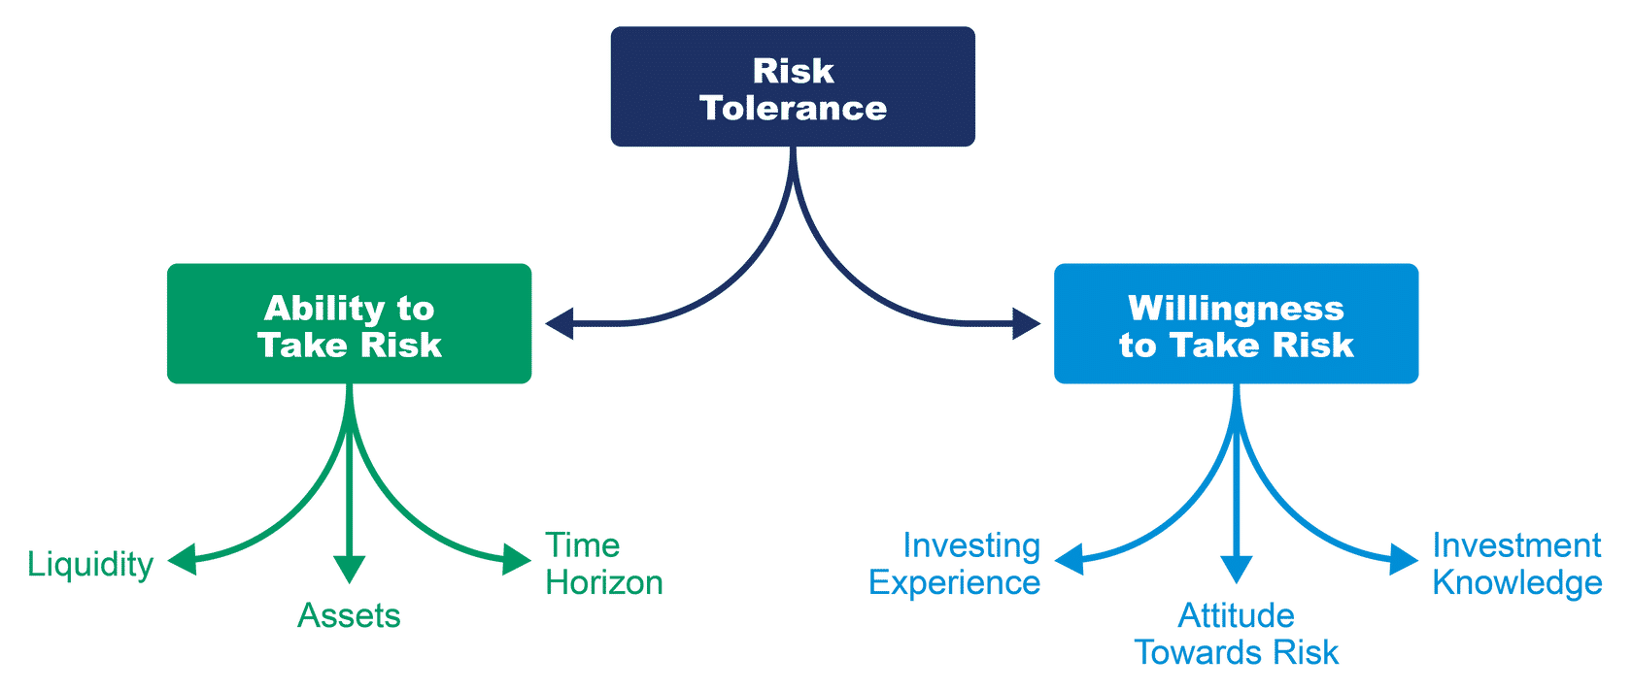
風險承受能力
投資者的風險承受能力取決於他們承擔風險的能力和意願。
Notes:
Risk Tolerance
An investor’s risk tolerance is a function of their ability and willingness to take on risk.
Notes:
Graphic: The ability to take risk is a function of liquidity, assets, and time horizon. The willingness to take on risk is a function of investing experience, attitude toward risk, and investment knowledge.
The time horizon matters because with a longer time horizon, there is more of a chance to recoup losses.
Willingness to take risks is related to the investor’s psychology.
Some institutional investors face regulatory restrictions (e.g., insurance companies, banks).
The ability to take on risk may differ from the willingness to take on risk.
Institutional and individual investors must be concerned with longevity risk—that is, the change that life expectancy exceeds expectations.
Discussion questions:
Why would an investor with a long-time horizon be willing to take on more risk?
If an investor requires a specified cash flow from investments, what level of risk might the investor be willing to take on?

Slide 16
流動性
當需要流動性時，投資必須輕鬆轉換為現金，而無需花費太多成本。
對於個人投資者來說，這可能會導致意外的開支。
對於機構投資者來說，這可能意味著在沒有足夠資金流入的情況下意外出現現金流出。
Notes:
Liquidity
When liquidity is required, investments must be readily converted to cash without too much cost.
For individual investors, this may result in unexpected expenses.
For institutional investors, this may mean unexpected cash outflows without sufficient inflows.
Notes:
In the case of a pension plan, a greater than expected number of retirements may strain the liquidity of the fund.
For an individual investor, that may mean a forced early retirement.
Discussion question:
What costs would be incurred from converting an investment into cash?

Slide 17
投資工具簡介

Slide 18
投資工具的類型
投資工具主要有四種類型：
  股本證券（股票）
  債務證券（債券）
  另類投資
  衍生品
每種投資類型都有不同的特徵，這些特徵會影響投資者的風險和他們可以預期獲得的回報。
Notes:
Types of Investment Instruments
There are four main types of investment instruments
Equity securities (stocks)
Debt securities (bonds)
Alternative investments
Derivatives
Each investment type has different characteristics that affect the risks to investors and the returns they can expect to achieve.
Notes:
Investment instruments exist because they respond to the needs of users of capital as well as to investors’ needs.
Equity securities are sometimes referred to as stocks or shares.
Debt securities are sometimes referred to as bonds.
Short-term bonds (maturity of one year or less) are sometimes referred to as bills.
Medium-term bonds (maturity of more than one year up to 10 years) are sometimes referred to as notes.
Discussion question:
Why do you think investment instruments exist?
NOTE: Terms that are bolded indicate glossary terms. Graded components of the Investment Foundations Certificate assess both learner understanding of terminology as well as the principles conveyed.

Slide 19
投資工具簡介
股本證券（股票）簡介

Slide 20

普通股估值的方法
普通股的估值是一個複雜的過程，因為它們的壽命是無限的，而且很難估計未來的公司業績。
普通股估值有三種基本方法：
  貼現現金流量估值
  相對估值
  資產估值
Notes:
Approaches to Valuing Common Shares
Valuing common shares is a complex process because of their infinite life and the difficulty of estimating future company performance.
There are three basic approaches to valuing common shares:
Discounted cash flow valuation
Relative valuation
Asset-based valuation
Notes:
Analysts frequently use more than one approach to estimate the value of a common share.
Once an estimate of value has been determined, it can be compared with the current price of the share, assuming that the share is publicly traded, to determine whether the share is overvalued, undervalued, or fairly valued.
Discussion question:
Why it might be easier to value a preferred share than a common share?

Slide 21
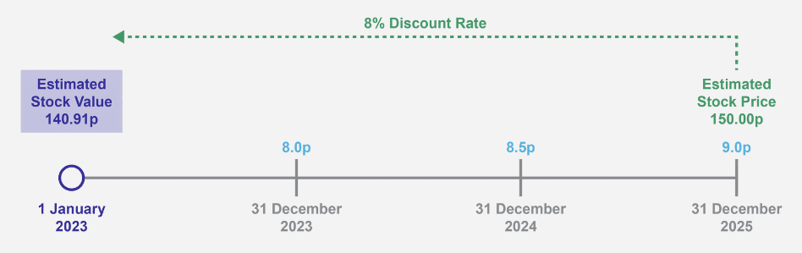
貼現現金流估值
貼現現金流 （DCF） 估值方法將證券的價值估計為投資者期望從證券中獲得的所有未來現金流的現值。
Notes:
Discounted Cash Flow Valuation
The discounted cash flow (DCF) valuation approach estimates the value of a security as the present value of all future cash flows that the investor expects to receive from the security.
Notes:
Common shareholders expect to receive two types of cash flows from investing in equity securities: dividends and the proceeds from selling their shares at a later date.
The DCF valuation approach applied to common shares relies on an analysis of the characteristics of the company issuing the shares, such as the company’s ability to generate earnings, the expected growth rate of earnings, and the level of risk associated with the company’s business environment.
Expected future cash flows should be discounted using a discount rate that is appropriate given the risk of the equity security.
A company’s value can also be estimated using the DCF approach as the present value of expected future free cash flows.
Valuing preferred shares is typically easier than for common shares because the expected dividends are known and fixed (do not change over time).
Discussion question:
How might an investor determine the expected stock price at the end of the investor’s holding period?

Slide 22
相對估值
相對估值方法將普通股的價值估計為某些衡量標準的倍數，例如每股收益 （EPS） 或每股收入。
相對估值依賴於使用可比上市公司的價格倍數或行業平均水平。
相對估值中常用的一個倍數是本益比 （P/E），即公司股價與每股收益的比率。
例：
一家航空公司的每股收益為 2.00 美元。一位分析師發現，航空業的平均市盈率爲9。
然後估計公司股票的每股價值為：
2.00 歐元 x 9 = 18.00 美元
Notes:
Relative Valuation
The relative valuation approach estimates the value of a common share as the multiple of some measure, such as earnings per share (EPS) or revenue per share.
Relative valuation relies on the use of price multiples of comparable, publicly traded companies or an industry average.
One multiple commonly used in relative valuation is the price-to-earnings ratio (P/E), which is the ratio of a company’s stock price to its EPS.
Example:
An airline company generates EPS of EUR2.00. An analyst finds that the average P/E for the airline industry is 9.
The value per share of the company’s shares is then estimated to be EUR2.00 x 9 = EUR18.00
Notes:
The multiple is determined based on price and the relevant measure for publicly traded, comparable equity securities.
Relative valuation relies on the use of price multiples of comparable, publicly traded companies or an industry average.
The key assumption of the relative valuation approach is that common shares of companies with similar risk and return characteristics should have similar values.
Discussion question:
Trying to determine the value of a residential home is an example of an application of relative valuation. When a potential home buyer finds a home they are interested in buying, what do you think are the relative factors that help the potential buyer determine an appropriate value (or price to pay) for the house?

Slide 23
資產估值
基於資產的估值方法通過估計公司的資產淨值來估計普通股的價值。
公司的資產淨值等於公司總資產與未償負債的市值之差。
基於資產的估值方法隱含地假設公司被清算，出售所有資產，然後償還所有負債。
清償所有負債後的剩餘價值是對股東的價值。
Notes:
Asset Valuation
The asset-based valuation approach estimates the value of common stock by estimating the company’s net asset value.
The company’s net asset value is equal to the difference in the market value of a company’s total assets and its outstanding liabilities.
The asset-based valuation approach implicitly assumes that the company is liquidated, sells all its assets, and then pays off all its liabilities.
The residual value after paying off all liabilities is the value to the shareholders.
Notes:
The difference between total assets and total liabilities on a company’s balance sheet represents shareholders’ equity, or the book value of equity.
However, the values of some assets on the balance sheet are based on historical cost (the cost when they were purchased), and the actual market values of these assets may be very different. To improve the accuracy of the value estimate, current market values can be estimated instead.
Some assets may not be included on the balance sheet because of financial reporting rules. For instance, some internally developed intangible assets, such as a brand or reputation, may not be listed in financial reports. It is important that analysts using asset-based valuation estimate reasonable values for all of a company’s assets, which can be challenging to do.
Discussion question:
If a company goes out of business and is liquidated, why might it have to sell its assets below their fair market values?

Slide 24
投資工具簡介
債務證券（債券）簡介

Slide 25
債務證券的特點
債券發行具有不同的特徵，影響其預期回報、風險和價值。
所有債券都有三個特點：
面值：債券到期時發行人將支付的金額
  票面利率：債券的承諾利率
  到期日：債券到期日（貸款結束）
這些特徵定義了債券的承諾現金流以及這些流動的時間。
Notes:
Features of Debt Securities
Bond issues have different features attached to them, which affect their expected return, risk, and value.
All bonds have three features:
Par value: the amount that will be paid by the issuer when the bond matures
Coupon rate: the promised interest rate on the bond
Maturity date: the date on which the bond matures (loan ends)
These features define the promised cash flows of the bond and the timing of these flows.
Notes:
Because debt securities were historically issued with fixed interest payments, they are sometimes referred to as fixed-income securities in financial markets.
A bond’s coupon payments are linked to the bond’s par value and the bond’s coupon rate. The annual interest owed to bondholders is equal to the product of the bond’s coupon rate and its par value.
Debt securities are issued in a wide range of maturities, from as short as one day to as long as 100 years (or more). In fact, some bonds are perpetual, with no prespecified maturity date. However, it is rare for new bond issues to have maturity of longer than 30 years.
Unlike some loans for which the borrower pays back principal with each payment during the life of the loan, issuers of bonds typically only pay interest during the life of the loan and pay back the principal (par value) at the end of the bond’s life on the maturity date.
Debt securities are sometimes referred to as bonds.
Short-term bonds (maturity of 1 year or less) are sometimes referred to as bills.
Medium-term bonds (maturity of greater than one year up to 10 years) are sometimes referred to as notes.
At issuance, investors buy bonds directly from an issuer in the primary market.
Bondholders may sell bonds they own to other investors in the secondary market. When investors buy bonds in the secondary market, they are entitled to receive the bonds’ remaining promised payments, including coupon payments until maturity and principal at maturity.
Discussion questions:
How might an investor determine how much actual interest they will earn each year from buying a particular bond?
Why might a company want to issue a bond with a short maturity (e.g., 2–3 years)?
Why might a company want to issue a bond with a long maturity (e.g., more than 10 years)?

Slide 26

債券類型
以下是發行的三種主要債務證券類型：
固定利率債券
浮息債券
零息債券
Notes:
Types of Bonds
Following are the three main types of debt securities issued:
Fixed-rate bonds
Floating-rate bonds
Zero-coupon bonds
Notes:
The three bond types are discussed in detail on the next three slides.
Discussion question:
What do you think is implied by a fixed-rate bond? Floating-rate bond? Zero-coupon bond?

Slide 27
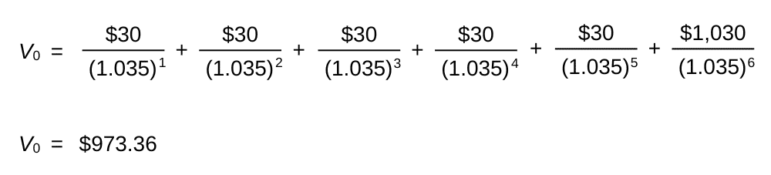
債券估值
貼現現金流 （DCF） 估值方法將債券的價值估計為所有未來利息和本金支付的現值。 貼現率代表投資者考慮到債券的風險，對債券的要求回報率。
例如：面值為 1,000 美元、票面利率為 6% 的三年期債券（半年支付債券）。適用的折扣率為 7%。
Notes:
Valuing Bonds
The discounted cash flow (DCF) valuation approach estimates the value of a bond as the present value of all future interest and principal payments. The discount rate represents the investor’s required rate of return on the bond given its riskiness.
Example: The three-year bond with a par value of USD1,000 and coupon rate of 6% (semiannual-pay bond). The applicable discount rate is 7%.
Notes:
Graphic:
The expected payments may not occur if the issuer defaults. Therefore, when estimating the value of a debt security using the DCF approach, an analyst or investor must estimate and use an appropriate discount rate that reflects the riskiness of the bond’s cash flows.
The expected cash flows of bonds with higher credit risk should be discounted at relatively higher discount rates, which results in lower estimates of value.
For floating-rate bonds, the interest payments are not known in advance, but they can be reasonably estimated.
If interest rates increase after issuance, the bond value will fall as the appropriate discount rate will increase. Similarly, if interest rates decrease after issuance, the bond value will rise as the appropriate discount rate will decrease.
Discussion question:
What happens to the value of a fixed-rate bond if interest rates in the economy increase?

Slide 28
當前收益率
債券投資者通常參考兩種常見的收益率指標來近似債券的預期回報：當前收益率和到期收益率。
當前收益率僅為債券持有人提供了票息收入的年化回報估計，而不必擔心債券價值隨時間變化而導致的任何資本收益或損失的影響。
示例：票面利率為 4% 的五年期債券售價為 914.70 美元：
  當前收益率 = 40 美元 / 914.70 美元 = 4.37%。
Notes:
Current Yield
Bond investors typically refer to two common yield measures to approximate a bond’s expected return: current yield and yield to maturity.
The current yield provides bondholders with an estimate of the annualised return from coupon income only, without concern for the effect of any capital gain or loss resulting from changes in the bond’s value over time.
Example: A five-year bond with coupon rate of 4% is selling for $914.70: Current yield = $40 / $914.70 = 4.37%.
Note:
The current yield is used because it is easy to calculate. Because it considers only coupon income and not the effect of any capital gain or loss from changes in the bond value over time, it is not as accurate as an estimate of expected return as the yield to maturity (see next slide).
Discussion question:
What do you think is a shortcoming of using current yield as an estimate of a bond’s expected return?

Slide 29
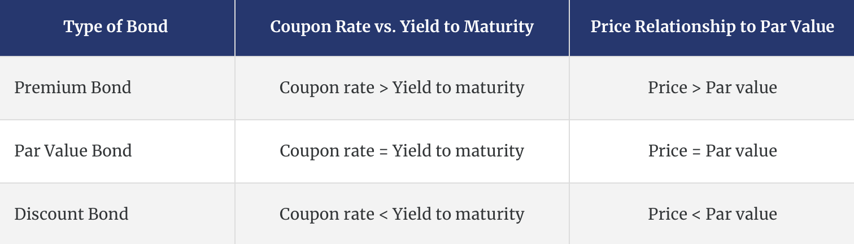
到期收益率
債券的到期收益率 （YTM） 或收益率為債券持有人提供了以當前市場價格購買債券並持有至到期的年化回報的近似值。
票面利率與貼現率（或到期收益率）之間的關係會影響債券相對於其面值的價值。
Notes:
Yield to Maturity
A bond’s yield to maturity (YTM), or yield, provides bondholders with an approximate of the annualised return from buying the bond at the current market price and holding it until maturity.
The relationship between the coupon rate and the discount rate (or yield to maturity) affects the bond’s value relative to its par value.
Notes:
Graphic: As shown in the table:
If the bond’s coupon rate and the yield to maturity are the same, the bond’s value is equal to its par value. Such a bond is referred to as a par bond.
If the bond’s coupon rate is lower than the yield to maturity, the bond’s value will be less than its par value. Such a bond is referred to as a discount bond.
If the bond’s coupon rate is higher than the yield to maturity, the bond’s value will be higher than its par value. Such a bond is referred to as a premium bond.
The discount rate that equates the present value of a bond’s promised cash flows to its market price is the bond’s YTM, or yield.
A shortcoming of the yield to maturity is that it is not easy to calculate. However, bond YTMs are regularly reported for investors—no need to calculate.
The YTM is a better estimate of a bond’s expected return because it factors in all cash flows (coupon income and any gain/loss from changes in the value of the bond).
Discussion questions:
What will happen to the value of a premium bond over time as it nears its maturity date?
What will happen to the value of a discount bond over time as it nears its maturity date?

Slide 30
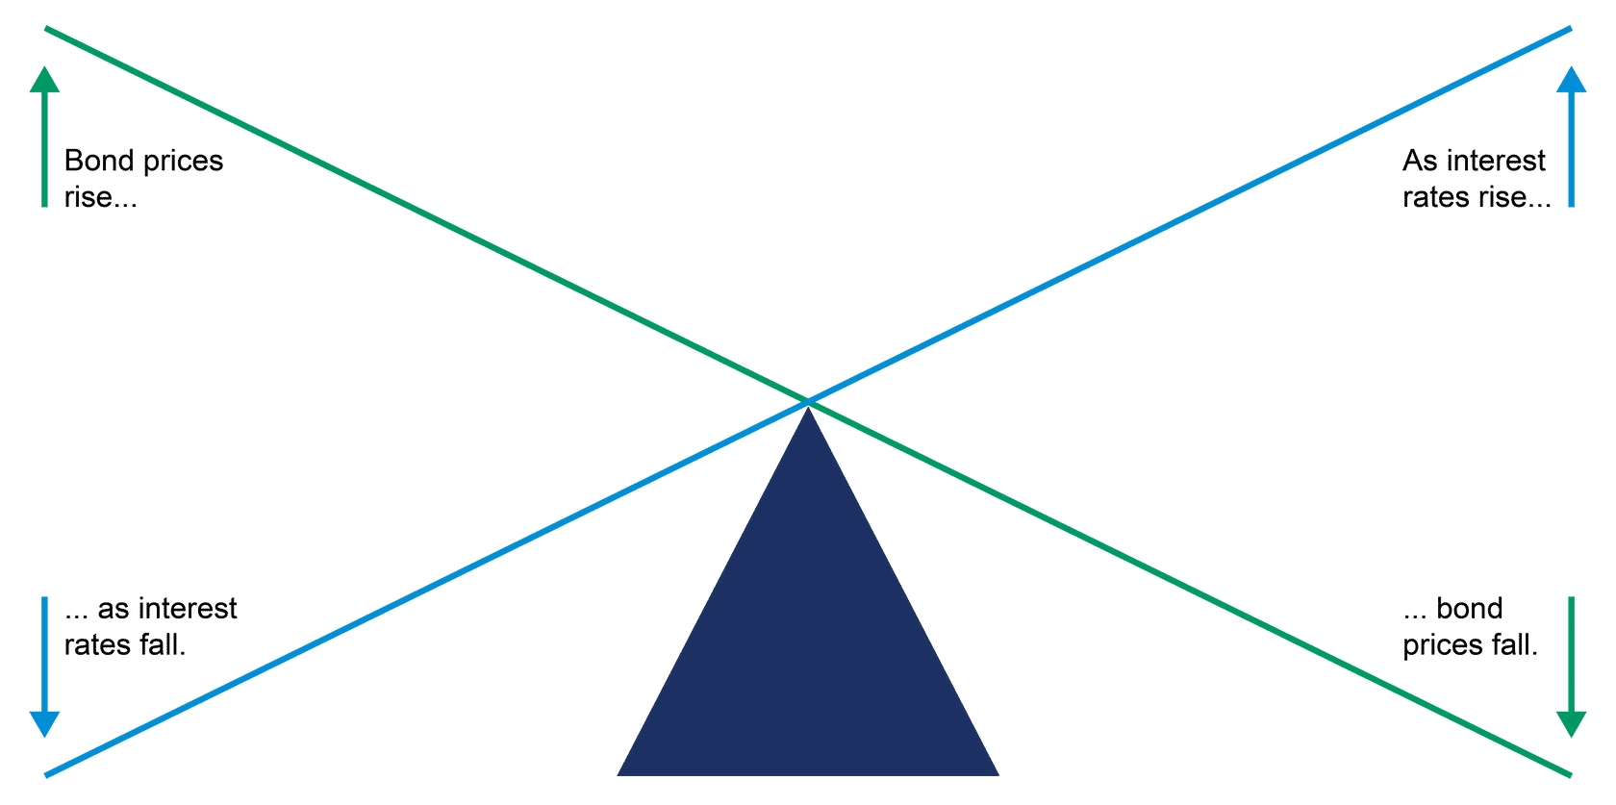
債券價格與利率的關係
債券價格及其到期收益率 呈負相關：
隨著債券價格下跌，其到期收益率增加，
隨著債券價格上漲，其到期收益率下降。
Notes:
Relationship between Bonds Prices and Interest Rates
Bond prices and their YTMs are inversely related:
As bond prices fall, their YTMs increase, and as bond prices rise, their YTMs decrease.
Notes:
Graphic:
When interest rates in the economy fall, the discount rates used to calculate the present value of a bond’s cash flows fall, resulting in a higher present value (higher price).
When interest rates in the economy rise, the discount rates used to calculate the present value of a bond’s cash flows rise, resulting in a lower present value (lower price).
Discussion question:
What do you think explains this inverse relationship between bond prices and yields to maturity?

Slide 31
投資工具簡介
比較股本和債務證券

Slide 32
債務及股本證券的風險狀況
債務證券
股本證券
債務證券的風險低於股本證券，因為與股本不同，債務資本代表公司的合同負債。
債務證券在債權優先權方面高於股本證券。
優先股的風險低於普通股，因為它在索賠優先權方面的排名高於普通股。
普通股是風險最高的證券，因為股東排在最後，被稱為公司的剩餘索賠人。
Notes:
Risk Profiles of Debt and Equity Securities
Debt Securities
Debt securities are less risky than equity securities because, unlike equity capital, debt capital represents a contractual liability of the company.
Debt securities are higher than equity securities in the priority of claims.
Equity Securities
Preferred stock is less risky than common stock because it ranks higher than common stock in the priority of claims.
Common stock is the riskiest security because shareholders are last in line and are known as the residual claimants in a company.
Notes:
Common shareholders share the remaining assets proportionately after all other claims have been satisfied.
If funds are insufficient to pay off all claims, equity investors will likely receive only a fraction of their investment back or may even lose their entire investment. Accordingly, investing in equity securities is riskier than investing in corporate debt securities.
Common stock is considered the riskiest of the three because it ranks last in the seniority ranking when it comes to the payment of dividends and distribution of net assets if the company is liquidated.
Equity investors are, however, protected by limited liability, which means that higher claimants, particularly debt investors, cannot recover money from other assets belonging to the shareholders if the company’s assets are insufficient to fully cover their claims (except in cases of fraud and wilful negligence). By legally separating the shareholders from the company, an individual shareholder’s liability is limited to the amount he or she invested. So, shareholders cannot lose more money than they have invested in the company.
Discussion question:
In the event of a bankruptcy, which group of investors is likely to lose more: bondholders or shareholders?

Slide 33
債務及股本證券的回報概況
債務證券
股本證券
債務證券的回報潛力有限，因為如果公司表現良好，現金流（利息、股息和面值償還）不會增加。
固定利率和零息債券的預期現金流量是預先知道的，對於浮動利率債券來說，估計是相當合理的。
優先股的回報潛力也僅限於規定的股息率（無論公司業績如何）。
普通股股東的回報潛力更高，因爲如果公司表現良好，股價就會上漲。
相對於債務證券和優先股的所有者，普通股股東期望獲得更高的回報，但必須接受更大的風險。
Notes:
Return Profiles of Debt and Equity Securities
Debt Security
The return potential for debt securities is limited because the cash flows (interest, dividends, and repayment of par value) do not increase if the company performs well.
The expected cash flows of fixed-rate and zero-coupon bonds are known in advance and are fairly reasonable to estimate in the case of floating-rate bonds.
Equity Securities
The return potential for preferred stock is also limited to the stated dividend rate (regardless of company performance).
The return potential for common shareholders is higher because the share price rises if the company performs well.
Relative to owners of debt securities and preferred stock, common shareholders expect a higher return, but must accept greater risk.
Notes:
The voting rights of common shareholders may give them some influence over the company’s business decisions and thereby may somewhat reduce risk.
Because equity is riskier than debt, risk-averse investors may prefer debt securities to equity securities. Although debt securities are safer than equity securities for a given entity, debt securities are not risk free; they are subject to many risk factors as discussed in Course 6.
Given the fact that equity securities are riskier than debt securities, shareholders expect to earn higher returns on equity securities over the long term.
A review of historical returns for debt and equity securities shows that equity investors indeed earn higher returns: The data are generally consistent with the expectation that riskier equity securities should generate higher returns over the long term than lower risk debt securities.
Discussion questions:
What is the best possible outcome in terms of dollar return for a bond investor? A preferred stock investor? A common stock investor?
What is the worst-case scenario in terms of dollar return for all investors?

Slide 34
投資工具簡介
另類投資簡介

Slide 35
另類投資和衍生品
另類投資被廣泛定義為傳統公開交易的股票和債務證券之外的投資，例如房地產、大宗商品、私募股權和對沖基金。
另類投資可以幫助投資者提高投資組合的回報並降低風險。
衍生性商品是從標的資產的表現中獲取價值的合約。
衍生性商品的存在是為了幫助投資者和借款人管理未來風險，例如股票或商品價格、利率、匯率或天氣等非財務因素的變化。
Notes:
Alternative Investments and Derivatives
Alternative investments are broadly defined as investments outside traditional publicly traded equity and debt securities, such as real estate, commodities, private equity, and hedge funds.
Alternative investments can help investors enhance returns and reduce risk in a portfolio of investments.
Derivatives are contracts that derive their value from the performance of an underlying asset.
Derivatives exist to help both investors and borrowers manage future risks, such as changes in stock or commodity prices, interest rates, exchange rates, or nonfinancial factors, such as weather.
Notes:
Types of derivative securities include forward contracts, future contracts, options, and swaps.
Discussion question:
What might be the motivations behind investors wanting to invest in alternative investments and/or derivatives?

Slide 36
另類投資簡介
另類投資是不屬於債務證券和股本證券等傳統資產類別的投資。
另類投資的類型通常包括以下幾種：
  私募股權投資：投資私人公司（未在證券交易所上市的公司）
  房地產投資：直接或間接投資土地和建築物
  商品投資：投資實物產品，例如貴金屬和賤金屬（例如黃金、銅）、能源產品（例如石油）和通常消費的農產品（例如玉米、牛、小麥）或用於製造商品（例如木材、棉花、糖）
Notes:
Introduction to Alternative Investments
Alternative investments are investments that fall outside the traditional asset classes of debt securities and equity securities.
Types of alternative investments typically include the following:
Private equity investments: Investments in private companies (companies that are not listed on a stock exchange)
Real estate investments: Direct or indirect investments in land and buildings
Commodity investments: Investments in physical products, such as precious and base metals (e.g., gold, copper), energy products (e.g., oil), and agricultural products that are typically consumed (e.g., corn, cattle, wheat) or used in the manufacture of goods (e.g., lumber, cotton, sugar)
Notes:
Although alternative investments have gained prominence in the 21st century, they are not new; in fact, real estate and commodities are among the oldest types of investments.
Banks often do not finance new and young companies because the risk of not getting the money back is high. So, entrepreneurs or young companies may turn to the venture capital sector to obtain the money they need.
Venture capital is a form of private equity. Venture capitalists specialise in financing new and young companies. They provide entrepreneurs and young companies with both the capital and the expertise to launch and grow their businesses and to develop track records of successful operations.
Private credit is another important asset class for such investors, showing the biggest year-over-year increase in current allocation.
Discussion question:
Why might investors be interested in investing in alternative investments, such as private equity, real estate, or commodities (provide one or two reasons)?

Slide 37
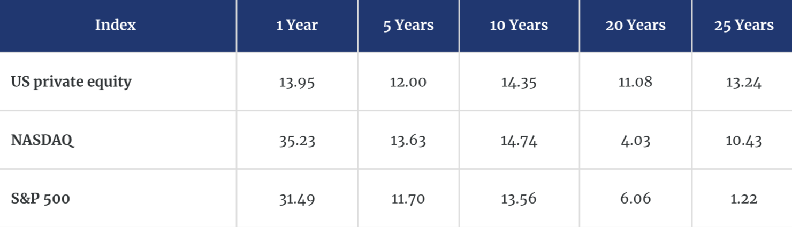
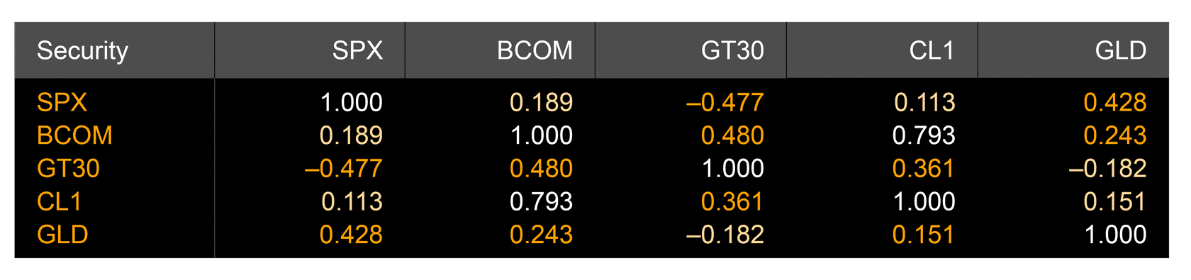
另類投資的優勢
另類投資有可能提高投資組合回報。
另類投資還可以通過提供多元化優勢的另類投資來降低投資組合風險。
Historical Returns 1990–2020
Correlation Matrix among Asset Classes
Notes:
Advantages of Alternative Investments
Alternative investments potentially enhance portfolio returns.
Alternative investments also can lower portfolio risk by alternative investments providing diversification benefits.
Notes:
Historical Returns, 1990–2020
Over the prior 25-year period, investments in US private equity have outperformed investments in US equity securities.
If two assets or securities do not have a correlation of +1 (i.e., if they are less than perfectly positively correlated), then combining the two assets or securities in a portfolio provides diversification benefits and thus reduces risk in the portfolio.
Because there is a relatively low correlation between different types of alternative investments, and also between alternative investments and other asset classes (like stocks and bonds), adding private equity, real estate, and commodities to portfolios helps investors reduce risk.
Correlations among Asset Classes
The correlation coefficients between bonds (GT30) and crude oil (CL1) and gold (GLD) are 0.36 and −0.18 respectively; the correlation coefficients between stocks (SPX) and crude oil and gold are 0.11 and 0.43, respectively. These low correlation coefficients suggest that alternative investments provide diversification benefits.
Commodities are viewed as a hedge against inflation because of their intrinsic value.
Discussion question:
Why might alternative investments provide diversification benefits in a portfolio with traditional debt and equity securities?

Slide 38
另類投資的局限性
另類投資有幾個限制。
與債務和股權投資相比，它們是：
  監管較少;
  透明度較低;
  液體較少;和
  更難估價。
由於初創公司、土地或建築物的買賣並不頻繁，因此估值具有挑戰性，並且通常基於評估。
Notes:
Limitations of Alternative Investments
There are several limitations to alternative investments. Compared with dept and equity investments, they are:
less regulated;
less transparent;
less liquid; and
more difficult to value.
Because purchases and sales of start-up companies, land, or buildings are infrequent, valuation is challenging and is often based on an appraisal.
Notes:
Because alternative investments are less regulated and less transparent than traditional investments, such as equity and debt securities, individual investors are less likely to invest in them. Institutional investors may view this as an opportunity to take advantage of market inefficiencies.
Most alternative investments are illiquid—that is, they are difficult to sell quickly without accepting a significantly discounted price.
Some institutional investors, depending on their cash flow needs, may be willing and able to hold investments for long periods, so liquidity may be less important for them than for individuals or institutional investors that have liquidity constraints.
An appraisal is an assessment or estimation of the value of an asset and is subject to certain assumptions, which may not always be realistic.
Discussion question:
Why is it more difficult to value alternative investments than traditional, publicly traded debt and equity securities?

Slide 39
投資工具簡介
私募股權投資簡介

Slide 40
私募股權概述
私募股權公司投資於未在證券交易所公開交易的私營公司。
儘管人們通常提到私募“股權”，但私募投資可以包括股權和債務證券。
私人債務包括直接貸款（在沒有中介機構的情況下發放的私人貸款）、夾層債務（私人次級債務）、風險債務（向初創或早期公司的私人貸款）和不良債務貸款（向有違約風險的公司提供的債務）。
Notes:
Overview of Private Equity
Private equity firms invest in private companies that are not publicly traded on a stock exchange.
Although people commonly refer to private “equity,” private investments can include both equity and debt securities.
Private debt includes direct lending (private loans made without intermediaries), mezzanine debt (private subordinated debt), venture debt (private loans to start-up or early stage companies), and distressed debt lending (debt extended to companies that are at risk of defaulting).
Notes:
The following example might help frame private equity:
Consider an entrepreneur who set up her new business five years ago. She turned to her friends and neighbours for the money she needed.
Now, five years later, her company is very successful. To raise the additional capital the company requires to support its growth plans, it could issue shares to the public via an initial public offering (IPO).
But it was not yet ready to go public, and the company needed more money to grow than the entrepreneur, her friends, neighbours, and banks were able or willing to provide.
Who would have financed such a young and not well-established company? The answer is venture capitalists. The entrepreneur sold some of her company’s shares to a venture capital firm, a type of private equity firm, to get the additional capital necessary to grow her business.
Discussion question:
What do you think is riskier? Investing in smaller, private companies or larger, publicly traded companies? Why?

Slide 41
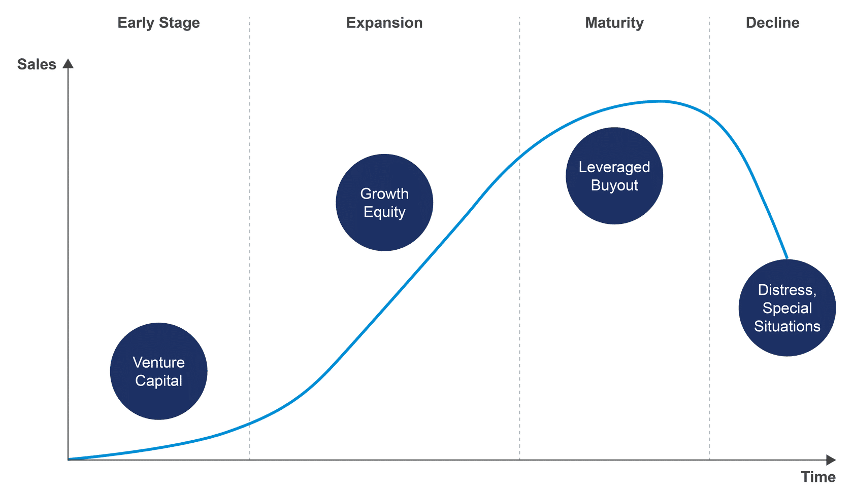
私募股權策略
私募股權包含多種策略，可能有助於為處於不同發展階段的公司提供資金。
使用最廣泛的策略是風險投資、成長型股權、槓桿收購和不良資產（即特殊情況）。
Notes:
Private Equity Strategies
Private equity encompasses several strategies that may help provide money to companies at different stages of their development.
The most widely used strategies are venture capital, growth equity, leveraged buyouts, and distressed (i.e., special situations).
Notes:
Each of the four strategies are defined on the next four slides.
Another private equity investment strategy, which is unrelated to the stage of a company’s development, is called secondaries.
Discussion question:
What do you think is probably meant by distressed?

Slide 42
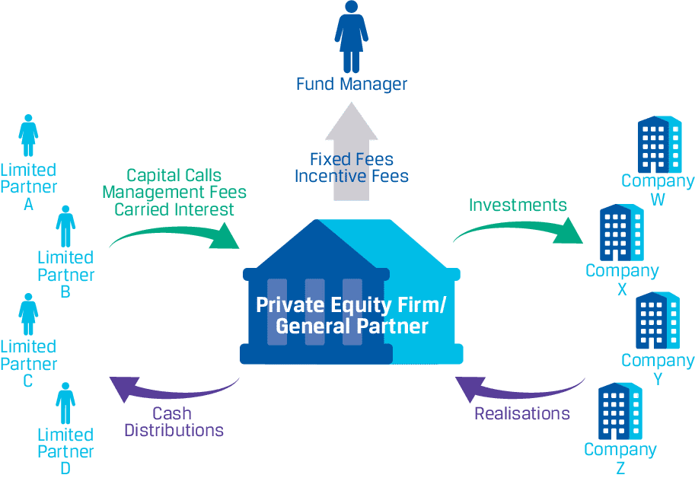
私募股權合夥企業的結構
私募股權投資通常由合夥企業管理的投資基金組織。
私募股權合夥企業通常包括兩種類型的合夥人：
  普通合夥人 （GP）
  有限合夥人 （LP）
Notes:
Structure of Private Equity Partnerships
Private equity investments are usually organised in investment funds managed by partnerships.
A private equity partnership usually includes two types of partners:
General partners
Limited partners
Notes:
A private equity firm may create different private equity funds for different types of investments.
Investments in private equity partnerships tend to be illiquid. That is, once the limited partners have committed capital to the partnership, it is difficult for them to exit the investment before the end of the commitment term.
Discussion question:
What are the key differences between the general partners and limited partners in a private equity partnership?

Slide 43
普通合夥人
合夥企業的普通合夥人 （GP） 負責籌集資金、尋找合適的投資並為合夥企業做出決策。
普通合夥人對合夥企業的所有債務承擔無限的個人責任——也就是說，普通合夥人的損失可能超過他們在合夥企業的投資，因為如有必要，他們的個人資產可用於償還合夥企業的債務。
私募股權公司通常擔任設立私募股權合夥企業的普通合夥人。
Notes:
General Partners
A partnership’s general partner (GP) is responsible for raising capital, finding suitable investments, and making decisions for the partnership.
GPs have unlimited personal liability for all the debts of the partnership—that is, GPs could lose more than their investment in the partnership because, if necessary, their personal assets could be used to pay the partnership’s debts.
Private equity firms often serve as GPs who set up private equity partnerships.
Notes:
The investments are usually not managed by the GP, but rather by professional fund managers who are hired by the GP.
Each private equity fund may have its own fund manager who is responsible for the day-to-day management of the investments in the funds.
GPs typically contribute only a very small percentage of the capital (1–5%) to the private equity partnership. Nearly all of the capital to fund investments comes from limited partners.
Discussion questions:
What are the key benefits of being a general partner? What is the biggest risk?
What skills and expertise do the general partner offer such that limited partners are willing to invest with them?

Slide 44
有限合夥人
有限合夥企業的有限合夥人 （LP） 是向合夥企業出資的投資者。
有限合夥人不參與投資的選擇和管理。
有限合夥人的個人責任有限，也就是說，有限合夥人的損失不能超過他們為合夥企業出資的資本金額。
Notes:
Limited Partners
The limited partners (LPs) of a limited partnership are investors who contribute capital to the partnership.
LPs are not involved in the selection and management of the investments.
LPs have limited personal liability—that is, LPs cannot lose more than the amount of capital they contributed to the partnership.
Notes:
LPs typically provide nearly all of the capital to fund investments in a private equity partnership.
In essence, LPs invest the capital to allow the general partner to hire the managers of the partnership’s investments.
Discussion question:
What do investors, who want to invest as limited partners in a private equity fund, seek in a partnership when trying to decide which partnerships to invest in?

Slide 45
私募股權公司費用結構
典型的私募股權公司通過兩種機制賺錢：
管理費：有限合夥人必須支付的費用，以補償他們管理私募股權投資的費用。
附帶權益：作為私募股權投資利潤的份額，附帶權益是普通合夥人在將投資利潤分配給有限合夥人之前扣除的一種激勵費形式。
Notes:
Private Equity Firm Fee Structure
The typical private equity firm makes money through two mechanisms:
Management fees: Fees that limited partners must pay general partners to compensate them for managing the private equity investments.
Carried interest: As a share of the profit on a private equity investment, carried interest is a form of incentive fee that general partners deduct before distributing to the limited partners the profit made on investments.
Notes:
Management fees are typically set as a percentage of the amount of money the limited partners have committed rather than the amount of money that has been invested.
Additionally, limited partners must pay management fees even if an investment is underperforming and must continue paying management fees even if an investment has failed.
Carried interest is designed to ensure that general partners’ interests are aligned with limited partners’ interests.
Private equity firm example: Assume that a private equity firm has created a USD4 million private equity fund to invest in start-up companies.
At inception:
The private equity firm is the general partner, and its first task is to raise capital from investors.
The firm identifies four investors who are willing and able to contribute USD1 million each. These investors are the limited partners.
The limited partners do not transfer USD1 million each to the general private equity firm immediately; initially, they agree to invest only USD1 million each over the commitment term of the private equity fund’s life (referred to as committed capital), say 10 years.
Investing period:
When the private equity firm has secured the USD4 million, it can start investing.
Assume that it finds a suitable investment in Company W for USD400,000. The private equity firm contacts the limited partners and makes a capital call of USD100,000 per limited partner; capital calls often happen at short notice.
The limited partners transfer USD100,000 each to the private equity firm, which invests the USD400,000 in Company W.
A few months later, the private equity firm identifies another suitable investment in Company X for USD600,000. It makes another capital call, this time of USD150,000 per limited partner.
This process may continue for several years until the private equity firm has invested the USD4 million.
These investments are typically managed by a professional fund manager who charges the private equity firm fees for his or her services. In turn, the private equity firm charges the limited partners management fees to cover the fund manager fees and other administrative fees.
Years later:
After several years, assume that the private equity firm sells its investment in Company W for USD1 million.
Before it distributes capital plus profit back to the limited partners, the private equity firm deducts a share of the profit, which is carried interest.
Suppose that carried interest is 15%. The profit on the investment in Company W is USD600,000—that is, the difference between the selling price of USD1 million and the initial investment of USD400,000. So, the private equity firm and the fund manager can keep USD90,000 (15% of USD600,000) in carried interest, which means that the amount of profit to be split between the limited partners is USD510,000 ($600,000 − $90,000).
Thus, ignoring management fees, each limited partner receives a cash distribution of USD227,500—that is, USD100,000 of capital plus USD127,500 of profit, which represents a return on investment of 128% [($227,500 − $100,000) ÷ $100,000].
Assume that Company X encounters financial trouble, and the private equity firm wants to sell its ownership interest in Company X. Another private equity firm is willing to buy this ownership interest, but for only USD100,000.
The investment in Company X turns out to be a loss of USD500,000 (the selling price of USD100,000 minus the initial investment of USD600,000), so there is no carried interest. Each limited partner receives a cash distribution of USD25,000, which represents a return on investment of −83% [($25,000 − $150,000) ÷ $150,000].
Discussion question:
Once committed to a new private equity fund, what do a limited partner’s expected cash flows look like early on (the first 3–5 years)? What about the later years?

Slide 46
風險管理

Slide 47
什麼是風險管理？
風險管理是識別和管理風險並減少不良事件影響，同時增強公司實現目標的能力的過程。
風險管理的目標包括幫助應對不確定性，以及識別威脅和機會。
風險管理的主要功能之一是在風險和回報之間找到適當的平衡。
雖然董事會和高級管理人員設定了適當的風險級別，但所有員工都應參與風險管理過程。
Notes:
What Is Risk Management?
Risk management is a process that identifies and manages risk and reduces the effects of adverse events while enhancing the ability of the company to achieve its objectives.
An objective of risk management is to help deal with uncertainty, identify threats, and identify opportunities.
One of the main functions of risk management is to find the right balance between risk and return.
Whereas the board of directors and senior management set the appropriate level of risk, all employees should be involved in the risk management process.
Notes:
The actions of one employee can damage the reputation of the company or even cause the demise of the company.
Discussion questions:
Why is it important for the back office to be involved in the risk management process?
Why is it important for the front office to be involved in the risk management process?

Slide 48
風險管理簡介
員工採取的任何行動都可能影響公司的風險狀況，並可能對公司造成損害。
風險是不確定的未來事件對公司或公司取得的結果的影響。
重點是具有負面影響的事件，但風險也包括帶來收益的積極影響。
風險按不確定性的來源進行分類。
Notes:
Introduction to Risk Management
Any action an employee takes may affect a company’s risk profile and can result in damage to the company.
Risk is the effect of uncertain future events on a company or on the outcomes the company achieves.
The focus is on events that have a negative effect, but risk encompasses positive effects that result in gains.
Risks are classified by the source of uncertainty.
Notes:
A good risk management process encompasses top management and all other employees.
Discussion questions:
Why would someone in the front office need to be involved in the risk management of a firm?
What are some of the external sources of risk for a company?
NOTE: Terms that are bolded indicate glossary terms. Graded components of the Investment Foundations Certificate assess both learner understanding of terminology as well as the principles conveyed.

Slide 49
投資行業風險
投資行業公司面臨的風險包括：
營運風險，即因人員、系統和內部政策和程序不足或失敗而造成的損失風險，包括公司無法控制的外部事件;
合規風險，即公司未能遵守所有適用的規則、法律和法規並因此面臨制裁的風險;和
投資風險，即投資價值波動引起的與投資相關的風險。
Notes:
Investment Industry Risks
The risks that companies in the investment industry are exposed to include:
operational risk, which is the risk of losses from inadequate or failed people, systems, and internal policies and procedures, and includes external events outside the control of the company.
Compliance risk, which is the risk that a company fails to follow all applicable rules, laws, and regulations and faces sanctions as a result; and
Investment risk, with is the risk associated with investing that arises from fluctuations in the value of investments.
Notes:
Each of these is discussed in the sections that follow.
Discussion questions:
Is there any possible interaction among these types of risk? If so, how?
What would be an example of a law or regulation that investment companies must abide by?

Slide 50
風險管理
投資風險

Slide 51
什麼是投資風險？
投資風險是與投資相關的風險，由證券價值的變化或獲得承諾現金流的風險所產生。
投資風險有幾種不同類型：
  市場風險是指因市場狀況變化而影響證券價格而產生的風險。
  信用風險是指借款人未能履行合約並及時支付利息和本金對貸款人的風險。
  流動性風險是指資產或證券在價格不大幅讓步的情況下無法快速買賣的風險。
Notes:
What Is Investment Risk?
Investment risk is the risk associated with investing, resulting from changes in the value of securities or the risk of receiving promised cash flows.
There are several different types of investment risk
Market risk is the risk caused by changes in market conditions that affect prices of securities.
Credit risk is the risk for a lender that the borrower fails to honour a contract and make timely payments of interest and principal.
Liquidity risk is the risk that an asset or security cannot be bought or sold quickly without a significant concession in price.
Notes:
There are also unique risks, which (as seen in the previous module) can be diversified away.
An example of a situation in which the downside of liquidity risk was experienced is the 2008 financial crisis.
Discussion questions:
What is the risk associated with debt securities?
Why is it that some securities cannot be sold quickly without a significant concession in price?

Slide 52
市場風險
市場風險可分為：
  股票價格風險，即與股價變動相關的風險;
  利率風險，即利率變動，影響債券價值的風險;
  外匯匯率風險，即匯率變化、改變現金流量價值的風險;和
  商品價格風險，商品（例如黃金）價格可能變動的風險。
Notes:
Market Risk
Market risk can be classified as
equity price risk, which is the risk associated with stock price changes;
interest rate risk, the risk that interest rates will change, affecting bond values;
foreign exchange rate risk, which is the risk that exchange rates will change, changing the value of cash flows; and
commodity price risk, the risk that the price of a commodity (e.g., gold) may change.
Notes:
Market risk does not consider the unsystematic or idiosyncratic risk of a security.
We often focus on the market risk of stocks, but there is market risk associated with other types of investments.
Discussion questions:
Which securities are likely to have which form of market risk?
How does market risk affect the pricing of a security?

Slide 53
信貸風險
在評估借款人的信用度時，需要同時考慮償還債務的能力和意願。
信貸風險的損失取決於：
  借出的金額;
  借款人違約的機率;和
  如果借款人違約，將產生的損失。
主權風險是指政府因無能力或不願償還而無法償還債務的風險。
Notes:
Credit Risk
Assessing the credit worthiness of borrowers, there is a need to consider both the ability and the willingness to repay the debts.
The loss from a credit exposure depends on
the amount of money lent;
the probability that the borrower defaults; and
the loss that would be incurred if the borrower defaults.
Sovereign risk is the risk that a government will not repay its debt because of an inability or unwillingness to repay.
Notes:
If there is collateral or third-party guarantees, this may reduce the risk.
Taking possession of collateral is time-consuming and expensive.
Sovereign risk is a form of credit risk, specific to sovereign debt.
Discussion questions:
What are some examples of sovereign risk?
How might the probability of the borrower defaulting be assessed?

Slide 54
流動性風險
流動性風險是指在價格不大幅讓步的情況下快速買賣的能力。
當市場流動性不足時，資產交易能力就會降低，這會對企業產生負面影響。
Notes:
Liquidity Risk
Liquidity risk is the ability to buy and sell quickly without incurring a loss.
When markets are illiquid, there is less ability to trade assets, which negatively affects firms.
Notes:
During the 2008 financial crisis, a shortage of liquidity resulted in failures. There was a severe demand for liquidity for immediate funding and for precautionary purposes, and typical lenders of liquidity stockpiled liquidity for their own safety.
As a result, the US Fed injected liquidity using a repurchase facility and lending facilities.
Discussion question:
Why does the inability to trade assets affect an investment firm?

Slide 55
系統性風險和特定風險
系統性風險是由經濟體系產生的風險。
  這種風險也稱為市場風險。
  它不能分散。
  投資者期望更高的系統性風險獲得更高的回報。
特定風險對於公司或證券來說是獨一無二的。
  這種風險稱為特殊、非系統性或非系統性風險。
  投資者可以通過在其投資組合中持有多種證券來降低特定風險。
  持有回報不相關的證券可以降低特定風險。
  由於特定風險可以分散，投資者不應期望承擔特定風險獲得更高的回報。
Notes:
Systematic Risk and Specific Risk
Systematic risk is risk that results from the economic system.
This risk is also known as market risk.
It cannot be diversified away.
Investors expect higher returns for higher systematic risk.
Specific risk is unique for a company or security.
This risk is known as idiosyncratic, nonsystematic, or unsystematic risk.
Investors can reduce specific risk by holding a number of securities in their portfolios.
Holding securities whose returns are not correlated reduces specific risk.
Because specific risk can be diversified away, investors should not expect higher returns for bearing specific risk.
Notes:
The key to reducing specific risk is finding securities whose returns are not perfectly positively correlated.
The lower the correlation, the better the reduction of specific risk.
The bottom line is that investors can diversify away specific risk.
Discussion questions:
Can some level of diversification be achieved even with equities that have positive correlation with one another?
Does taking on more market risk always result in higher returns?

Slide 56
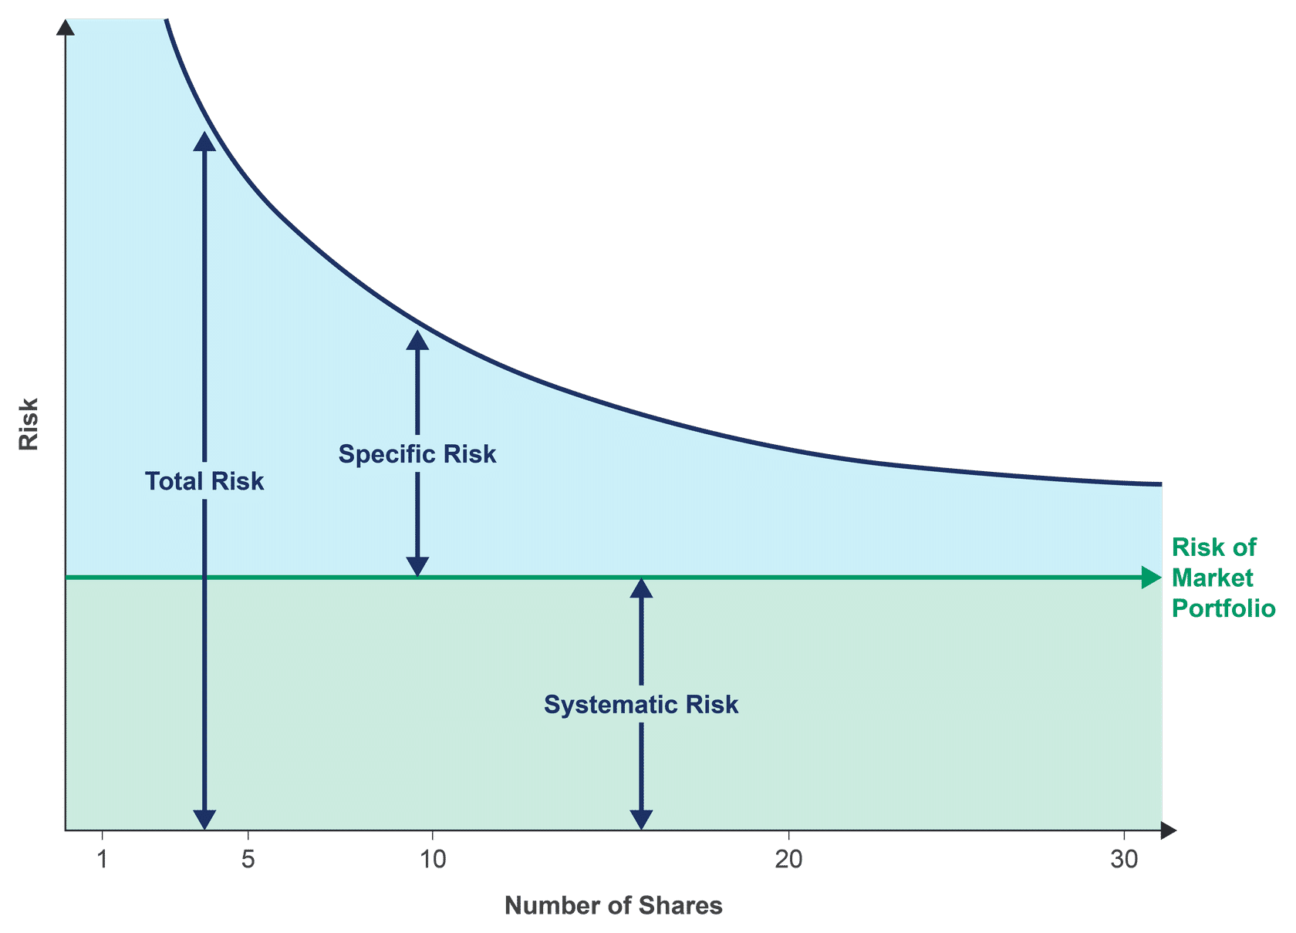
多元化
投資組合的回報是投資組合中資產回報的加權平均值。
如果投資組合的資產回報沒有完全相關，則風險將小於資產風險的加權平均值。
Notes:
Diversification
A portfolio’s return is the weighted average of the returns of the assets in the portfolio.
If the portfolio’s assets’ returns are not perfectly correlated, the risk will be less than the weighted average of the assets’ risk.
Notes:
Graphic: As more securities are added, the specific risk is reduced, but systematic or market risk is not.
Most equity securities are not perfectly positively correlated with one another, so adding different securities to the portfolio will reduce specific risk.
Adding other assets, such as debt securities and real estate, can reduce the overall risk of the portfolio. The expression used is that specific risk is “diversified away.”
Discussion questions:
What might be the effect of diversifying globally?
What type of stocks would likely have less correlation with other stocks?

Slide 57
風險管理
資產配置與投資組合建構

Slide 58
資產配置與投資組合建構
資產配置取決於投資者承擔風險的意願和能力。
資產配置決策涉及投資哪些資產類別以及投資組合在每種資產類別中的比例。
資產配置可在投資政策聲明中列明。
Notes:
Asset Allocation and Portfolio Construction
The asset allocation depends on the investors willingness and ability to take risk.
The asset allocation decision involves which asset classes to invest in and the proportion of the portfolio in each.
The asset allocation may be specified in the investment policy statement.
Notes:
The investor’s willingness and ability to take on risk are expressed in the investment policy statement.
Discussion questions:
What are the different types of asset classes?
What is an example of an asset allocation for a portfolio?

Slide 59
策略性資產配置
策略性資產配置是預期為滿足投資者目標而進行的長期資產組合。
策略性資產配置是根據投資者期望的風險和回報而定的。
戰略資產配置要求投資經理估計每種資產類別的預期風險和回報。
  歷史回報可以作為指導，但對回報的預期必須具有前瞻性。
  還必須考慮回報的相關性。
Notes:
Strategic Asset Allocation
Strategic asset allocation is the long-term mix of assets expected to meet the investor’s objectives.
The strategic asset allocation is based on the investor’s desired risk and return.
Strategic asset allocation requires that investment managers estimate expected risk and return for each asset class.
Historical returns may be used as a guide, but expectations of returns must be forward-looking.
Correlations of returns must also be considered.
Notes:
Maintaining an allocation over the long-term requires adjusting (i.e., rebalancing) periodically.
Discussion questions:
How useful are historical returns?
Why must correlations among the returns be considered?

Slide 60
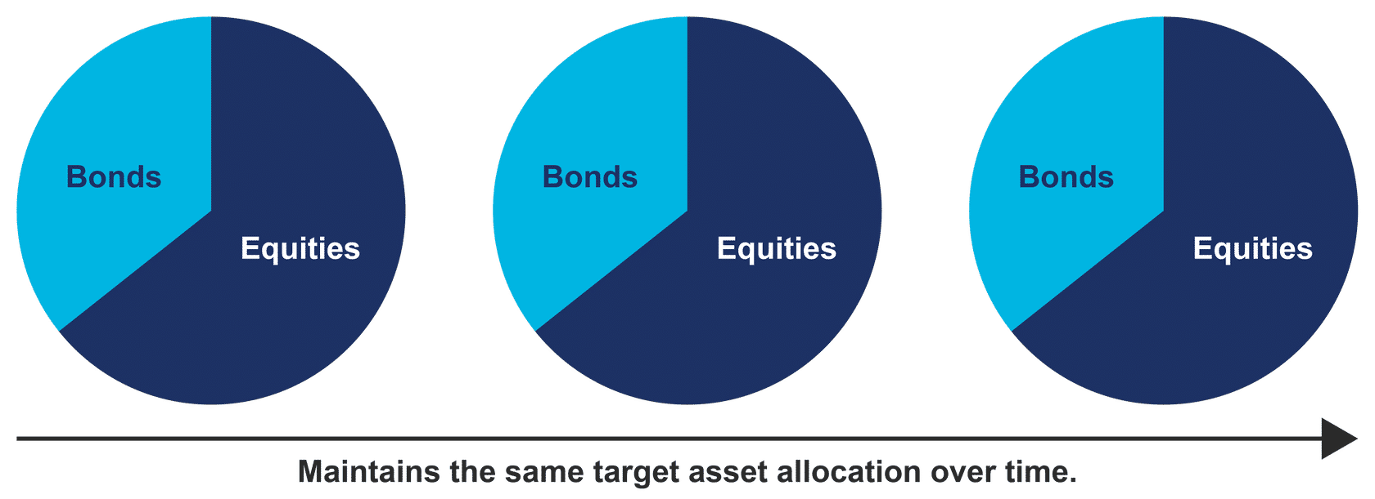
再平衡
再平衡是通過出售價值隨時間增加的資產類別的持有量和購買價值下降的資產類別的投資來維持資產配置。
Notes:
Rebalancing
Rebalancing is maintaining the asset allocation over time by selling holdings in asset classes that have increased in value over time and buying investments in asset classes that have decreased in value.
Notes:
There are trading costs to rebalancing, so rebalancing is generally done at specified intervals or based on the degree to which weightings have changed.
Discussion question:
What decision rule might trigger rebalancing?

Slide 61
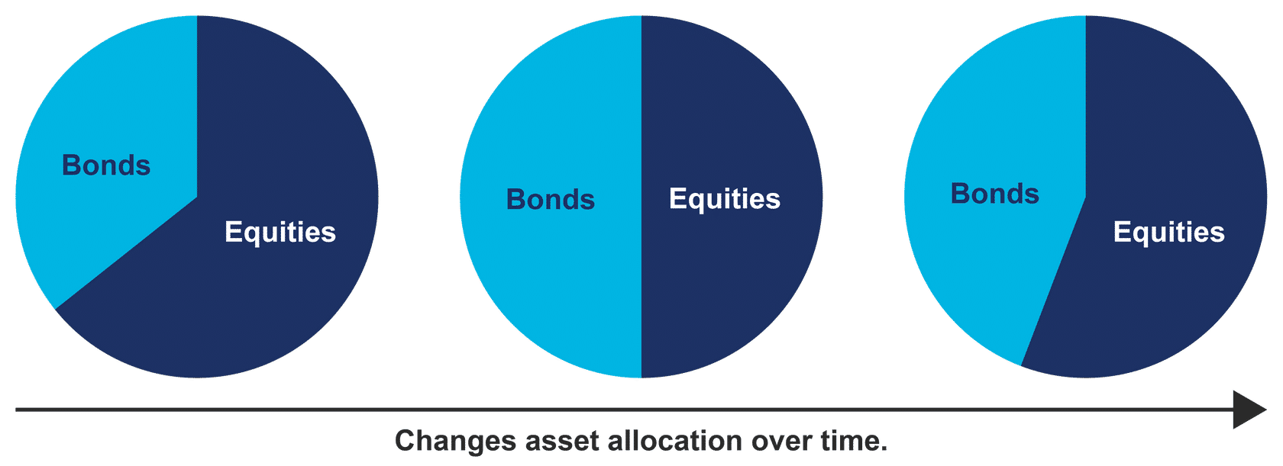
戰術資產配置
戰術資產配置是調整不同資產類別的比例以獲取更高的回報。
由於難以預測回報，戰術性資產配置並不總是對投資者有利。
Notes:
Tactical Asset Allocation
Tactical asset allocation is the adjustment of the proportions in the different asset classes to exploit increased returns.
Because it is difficult to forecast returns, tactical asset allocation does not always benefit the investor.
Notes:
A strategic asset allocation may specify a range of proportions for each asset class to avoid frequent rebalancing.
Tactical asset allocation uses fundamental analyses of economic and political conditions, market valuation measures, and trends and momentum in markets.
Tactical asset allocation is a form of active portfolio management.
Discussion questions:
What is the motivation for using tactical asset allocation?
What are the challenges to using tactical asset allocation strategies?

Slide 62
風險管理
被動和主動投資管理

Slide 63
被動和主動管理
被動投資管理旨在與特定基準的表現相匹配。
主動投資管理試圖通過選擇表現優於指定基準的投資來增加價值。
主動管理和被動管理之間的決定取決於投資者對市場效率的信念。
投資者在某些市場可選擇主動管理，而在其他市場選擇被動管理。
Notes:
Passive and Active Management
Passive investment management seeks to match the performance of a specified benchmark.
Active investment management attempts to add value by selecting investments to outperform a specified benchmark.
The decision between active and passive management depends on the investor’s beliefs about the efficiency of the markets.
An investor may choose active management in some markets and passive management in other markets.
Notes:
The benchmark may be, for example, the FTSE 1000.
Outperformance is regarding the risk-adjusted returns.
Choosing active management in an emerging market may lead to outperformance because of possible inefficiencies.
Discussion questions:
If an active strategy produces a higher return than a passive strategy, does this mean that the active strategy outperformed?
Why will the return on a passively managed portfolio be slightly less than the return on its benchmark?

Slide 64
市場效率
如果投資價格反映了有關證券基本價值和回報前景的所有可用信息，那麼市場在信息上是有效的。
在低效的市場中，股票可能被高估或低估。
效率低下可能涉及個別證券或整個市場。
效率低下可能是由於市場監管較少或調查市場和證券的分析師較少造成的。
房地產或私募股權等投資市場可能效率不高，因為公開資訊較少、交易較不活躍或私下交易。
Notes:
Market Efficiency
A market is informationally efficient if the prices of investments reflect all available information about the fundamental values and return prospects of the security.
In an inefficient market, shares may be over- or undervalued.
Inefficiency may pertain to individual securities or the entire market.
Inefficiencies may arise from less market regulation or fewer analysts investigating markets and securities.
The markets for investments, such as real estate or private equity, may not be efficient because of less public information, less active trading, or trading done privately.
Notes:
Some argue that emerging markets may have inefficiencies because of information flows that are less extensive or reliable.
Some argue that small companies’ securities are inefficiently priced because of fewer analysts following them.
Passive managers try to minimize tracking error—the difference between the portfolio’s return and that of the benchmark.
Passive management may involve:
owning all securities in the benchmark in the proportions they represent in the benchmark (i.e., full replication); or
owning a subset that tracks the benchmark.
Active portfolio managers select securities and may try to time the market in their trades.
Discussion questions:
Suppose someone concludes that a particular stock is undervalued. What questions would you ask this person about their conclusion?
How can regulations contribute to the efficiency of markets?

Slide 65
成功的主動管理
主動管理的成功需要更好地評估潛在投資。
可能有助於主動管理成功的因素包括：
  獲取更好的信息，
  快速響應的能力，以及
  利用錯誤定價的成本低於錯誤定價。
在許多市場，監管機構要求同時向所有市場參與者提供安全資訊。
大多數研究表明，主動管理在很長一段時間內並不會持續跑贏市場。
Notes:
Successful Active Management
Success in active management requires being better at assessing potential investments.
Factors that may contribute to success in active management include
access to better information,
ability to respond quickly, and
costs of exploiting a mispricing that are less than the mispricing.
In many markets, regulators require that that security information be made available to all market participants at the same time.
Most research shows that active management does not consistently outperform the market over long time periods.
Notes:
The research needed for valuation and trading are both costly, so the mispricing must be sufficiently large to exploit it.
Discussion questions:
Why do investment managers pursue active management strategies if, on average, they do not outperform the market on a risk-adjusted basis?
In an informationally inefficient market, how can someone outperform the market on a risk-adjusted basis?

Slide 66
被動管理與主動管理
被動管理 | 主動管理
實施成本更低 由於成本原因，回報率低於基準回報率 完善的紀律 基準測試的直接複製 不適用於某些具有獨特資產的市場，例如房地產。 | 由於需要熟練的員工和昂貴的技術，實施成本更高 由於交易更頻繁，交易成本更高 適用於獨特的資產，例如房地產
Notes:
Passive versus Active Management
Passive Management
Cheaper to implement
Lower return than the benchmark return because of costs
Well-established discipline
Straight-forward replication of the benchmark
Not applicable in some markets with unique assets, such as real estate.
Active Management
More costly to implement because of the need for skilled employees and expensive technology
Higher transactions costs because of more frequent trading
Appropriate for unique assets, such as real estate
Notes:
Unique assets include real estate and private equity.
Discussion question:
Which type of strategy, active or passive, would be most appropriate for an investor who does not like to take on a great deal of risk?

Slide 67
謝謝
免責聲明
本演示文稿僅供參考，內容不構成任何形式的投資建議、財務建議或購買、出售證券的要約或邀請。 投資涉及風險，投資者應根據自身的風險承受能力和財務狀況，獨立做出投資決策。 本演示文稿中的資訊、觀點及預測僅代表資料發佈時之觀點，可能隨時更改，且不保證其準確性、完整性或及時性。
本演示文稿及其內容不應被視為對任何個人或實體的具體投資建議。 本公司及相關方不對因使用或依賴本演示文稿中的任何資訊而引致的任何直接、間接或因果性損失承擔任何責任。 投資者應自行承擔所有投資風險和損失。
使用本演示文稿的個人或機構，視為已同意以上免責聲明並放棄追究任何相關責任的權利。

Slide 68
講者
程子樂先生 , CFA
(David Ching, CFA)
香港特許金融分析師學會
副主席

Slide 69
淺談虛擬資產
什麼是區塊鏈？

Slide 70
什麼是區塊鏈？
區塊鏈是一種特殊的資料庫。它是由分散式電腦網路維護的去中心化數位分類帳。區塊鏈資料組織成區塊，按時間順序排列，並受密碼學保護。
這種結構可確保資料透明、安全且不可篡改。在區塊被確認並新增到鏈上後，儲存在區塊中的資料幾乎不可能更改。去中心化結構也消除了對中央機構的需求。區塊鏈交易可以在用戶之間進行，不需要中間機構。
不同類型的區塊鏈具有不同程度的去中心化。儘管如此，區塊鏈一詞通常是指去中心化數位分類帳，用於記錄加密貨幣交易。

Slide 71
區塊鏈的主要特點和好處
去中心化 Decentralised：資訊儲存在電腦 (節點) 網路，而不是單一中央伺服器。像比特幣這樣的大型去中心化網路對攻擊具有很高的抵抗力。
透明度 Transparent/ Permissionless：大多數區塊鏈都是公開的，代表所有參與者都可以存取相同資料庫。所有參與者都可以看到交易。
不可篡改性 Immutable：一旦資料新增至區塊鏈，未經網路共識即無法更改。
資料安全 Safe：密碼學和共識機制可確保防範資料篡改。
效率 Efficient：區塊鏈消除了對中間機構的需求，可以實現更快速、更便宜的交易。交易以近乎即時的方式處理。

Slide 72
區塊鏈有什麼用途？
1. 加密貨幣: 區塊鏈技術的開發是為了支援加密貨幣創建，加密貨幣使用區塊鏈作為安全且去中心化的帳本，以記錄交易。傳統跨境交易涉及中間機構和高額手續費，而區塊鏈可實現更快速、更便宜且更透明的國際轉帳。除了價值儲存特性，許多人使用比特幣和其他加密貨幣進行全球匯款。
2. 智能合約: 智能合約是自動執行的合約，可設計成達到特定條件時自動執行。區塊鏈技術使智能合約能夠以安全和分散的方式創建和執行。 能合約最受歡迎的應用之一是供去中心化應用程式 (DApp) 和各種組織 (DAO) 使用，兩者都是去中心化金融 (DeFi) 平台的重要組成部分。DeFi 平台利用區塊鏈在沒有傳統機構的情況下提供借貸和交易等金融服務，使金融工具的使用民主化。
代幣化 (RWA), 數位身分, 投票, 供應鏈管理等

Slide 73
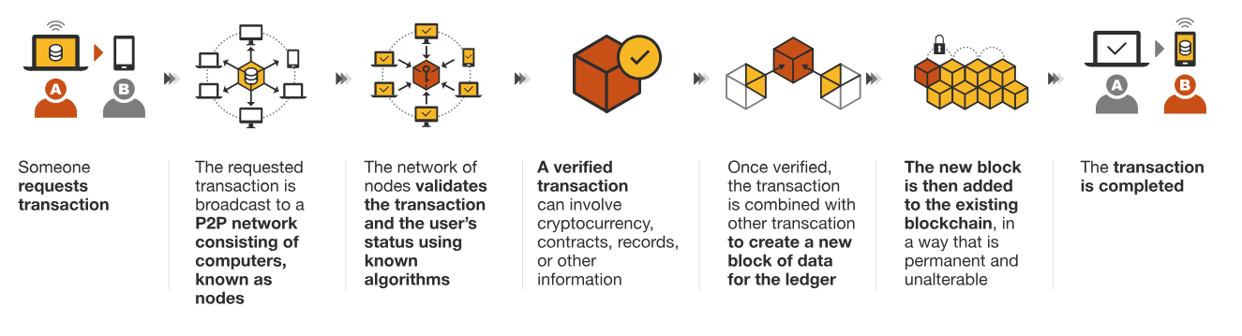
資料來源：Binance, Coinbase, Statista、Fitch、研究報告、Dune Analytics、DappRadar。市場數據截至 2024 年 12 月 31 日
備註：(1) 2020 年至2025 年根據 Statista 和企業披露的數據。2030 年數據基於 BCG 報告。(2) 普及率計算方式為加密貨幣持有者數量除以總人口數；總人口數及預測基於 Fitch 研究。

Slide 74
淺談虛擬資產
什麼是加密貨幣以及它如何運作？

Slide 75
什麼是加密貨幣以及它如何運作？
加密貨幣是由密碼學提供保護的數位貨幣，也是通常用作交易媒介的數位元資產。加密貨幣可以 24/7 全天候全球運作，並且獨立於銀行和支付處理器等仲介機構。加密貨幣的去中心化本質可促進個人之間的直接點對點 (C2C) 交易。因此，人們不是透過實體錢包和銀行帳戶，而是透過獨特的加密貨幣錢包或幣安等加密貨幣交易所存取並使用其加密貨幣。
比特幣 (BTC): 2008 年末，一個名叫中本聰 (Satoshi Nakamoto) 的人或團體在網上發表了一份白皮書，解釋了名為比特幣的新型數位貨幣背後的原理。此後的每種加密貨幣都是該文章提出概念的演變。BTC是首款也是最受歡迎的加密貨幣。它被廣泛用作價值儲存和交易媒介。 比特幣採用稱為工作量證明 (PoW) 的共識機制，其中礦工相互競爭以驗證交易，並換取區塊獎勵作為回報。此外，BTC 限量供應 2,100 萬枚代幣，使其相對稀缺，因而被稱為「數位黃金」。
乙太幣 (ETH): 乙太幣 (ETH) 是乙太坊區塊鏈的原生代幣。乙太坊由 Vitalik Buterin 創建，為去中心化網路提供支援，開發人員可以在其中使用智慧合約建構 DApp。乙太坊最初採用工作量證明 (PoW)，但隨後轉換成可提高效率並減少能源消耗的權益證明 (PoS)。此一更動可讓用戶透過質押 ETH 驗證交易並保障網路安全，無需透過節點使用算力。

Slide 76
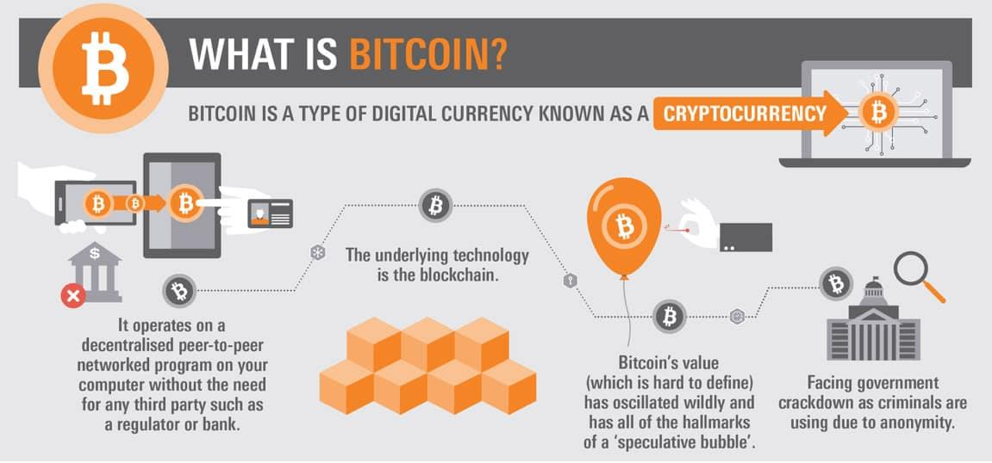
資料來源：Statista、Fitch、研究報告、Dune Analytics、DappRadar。市場數據截至 2024 年 12 月 31 日
備註：(1) 2020 年至2025 年根據 Statista 和企業披露的數據。2030 年數據基於 BCG 報告。(2) 普及率計算方式為加密貨幣持有者數量除以總人口數；總人口數及預測基於 Fitch 研究。

Slide 77
什麼是工作量證明？
工作量證明 (PoW) 是許多區塊鏈網路所使用的共識機制，用於驗證交易，並維護區塊鏈的完整性。這是比特幣最初使用的共識機制。在 PoW 中，礦工們相互競爭解決一個複雜的數學難題，以將下一個區塊新增至區塊鏈。在稱為挖礦的過程中，第一個解決問題的礦工將獲得加密貨幣獎勵。礦工必須使用功能強大的計算機來解決數學問題，開採新代幣並保護網路。這就是挖礦過程需要大量資源 (算力和能源) 的原因。
權益證明 (PoS) 是一種共識機制，旨在解決工作量證明 (PoW) 的一些缺點。在 PoS 系統中，礦工不需要相互競爭解決複雜的數學問題，以驗證交易並向區塊鏈新增區塊，驗證人根據其在網路中「質押」的加密貨幣數量選擇。質押代表驗證人持有作為抵押品的加密貨幣數量。PoS 驗證人通常會根據質押量的大小以隨機方式獲選，以創建新區塊並驗證交易。驗證人將獲得創建新區塊的交易手續費作為獎勵，並成為替網路爭取最佳利益的激勵。如果他們是惡意行為者，就有失去質押加密貨幣的風險。

Slide 78
加密貨幣如何運作？
交易資料在全球由分散式電腦網路 (節點) 記錄。當 A 向 B 發送一些比特幣時，交易會在網路上推播。每個節點都會驗證數位簽章和其他交易資料，以驗證交易。一旦交易通過驗證，便會與其他交易一起新增到區塊中。我們可以將每個區塊視為數位分類帳的一個頁面。區塊由加密方法串連在一起，形成區塊鏈。驗證交易並新增到區塊鏈的過程透過共識機制完成，這是一組治理網路節點針對區塊鏈狀態和交易有效性達成協議之方式的規則。

Slide 79
淺談虛擬資產
什麼是Web3/ 元宇宙？

Slide 80
什麼是Web3/ 元宇宙？
Web 1.0: 最初的網際網路提供一種現在稱為 Web 1.0 的體驗。該術語由作家和 Web 設計師 Darci DiNucci 於 1999 年在區分 Web 1.0 和 Web 2.0 時創建。在 1990 年代初期，網站使用只能顯示資訊的靜態 HTML 頁面構建。用戶無法變更資料或上傳自己的資料。社交互動僅限於簡單的聊天信差和論壇。
Web 2.0: 在 20 世紀 90 年代後期，開始向更具互動性的網際網路的轉變。藉助 Web 2.0，用戶能夠透過資料庫、伺服器端處理、表單和社交媒體與網站互動。這些工具將 Web 體驗從靜態變為動態。Web 2.0 更強調用戶產生的內容，以及不同站點和應用程式之間的互操作性。Web 2.0 更多地關注參與，而不是觀察。到 2000 年代中期，大多數網站都過渡到 Web 2.0，而大型科技公司開始建立社交網路和以雲端為基礎的服務。

Slide 81
什麼是Web3/ 元宇宙？
Web 3.0: 從網際網路的歷史來看，語義智慧型網路的演進在情理之中。資料首先以靜態方式呈現給用戶。然後用戶可以動態地與該資料互動。現在，演算法將使用所有這些資料來改善用戶體驗，並使網路變得更具個人化和熟悉感。您只需查看 YouTube 或 Netflix，即可瞭解演算法的強大功能，以及它們已經做出哪些改進。Web 3.0 雖然還沒有完全界定，但可以充分利用區塊鏈、開源軟體、虛擬現實、 物聯網 (IoT) 等點對點 (P2P) 技術。此外，Web 3.0 旨在讓網際網路更加開放和去中心化。在目前的架構中，用戶依賴可存取其個人資料和資訊的網路和蜂窩服務提供者。隨著分散式 Ledger 技術的出現，這種情況很快會改變，用戶可以收回其資料的擁有權。
元宇宙: 是持續存在的網路 3D 宇宙，並合併許多不同的虛擬空間。您可以把它想成未來的網路迭代，且用戶可在這些元宇宙的 3D 空間中一起工作、見面、玩遊戲，以及進行社交活動。元宇宙並不完全存在，但有些平台含有類似元宇宙的元素。電玩遊戲目前提供的體驗最接近元宇宙。開發人員會在遊戲中舉辦活動並創造虛擬經濟，藉此突破遊戲的界限。

Slide 82

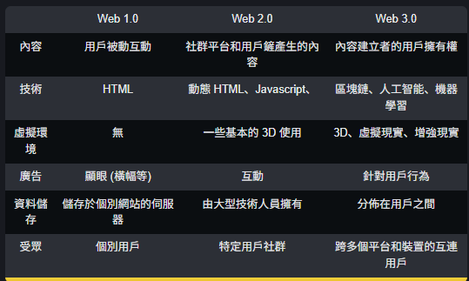
資料來源：Binance, Coinbase, Statista、Fitch、研究報告、Dune Analytics、DappRadar。市場數據截至 2024 年 12 月 31 日
備註：(1) 2020 年至2025 年根據 Statista 和企業披露的數據。2030 年數據基於 BCG 報告。(2) 普及率計算方式為加密貨幣持有者數量除以總人口數；總人口數及預測基於 Fitch 研究。

Slide 83
淺談虛擬資產
如何保護您的加密貨幣

Slide 84
如何保護您的加密貨幣
無論您是購買、儲存還是投資加密貨幣，應始終確保其安全性。在絕大多數情況下，遺失您的幣種及代幣是永久性的。
中心化交易所:您可以將加密貨幣保存在受監管的交易所中，這對入門者和交易者來說相當實用。然而，您並未擁有錢包的金鑰。請使用符合「認識你的客戶 (KYC) 」及「防制洗錢 (AML) 」檢查法規的加密貨幣。點對點交易和具備審計的去中心化交易所是保證您交易安全性的最佳方式。
由您保管金鑰的非託管型錢包可提供較高的安全性，更安全的選擇是將金鑰保存在未連接網際網路的錢包中，如冷儲存裝置。在這兩種情況下，請將您的私鑰安全保存在離線的安全之地。
使用經審計的 DApp 來提高您的安全性，並定期檢查授權使用您錢包的 DApp。使用完 DApp 後，請立即撤銷這些權限。

Slide 85
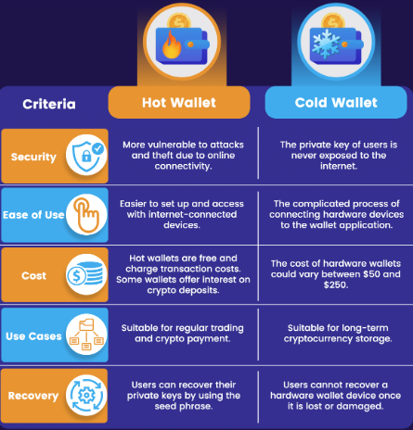
熱錢包與冷錢包
熱錢包: 連接至網際網路的加密貨幣錢包（例如智慧型手機及桌面版錢包）。順暢的用戶體驗但因為會連接到網際網路，所以容易受到攻擊。即使私鑰是安全保管，但您的連線裝置有機會被惡意參與者入侵或遙距控制。熱錢包相當容易使用，且往往都是較小餘額資金散戶的錢包首選。
冷錢包: 為了杜絕線上媒介的攻擊，許多人都會將其金鑰保持為離線狀態，使用冷錢包就是一種方式。有別於熱錢包，冷錢包不用連接網際網路。一張列印出錢包私鑰的白紙，通常以二維碼的形式存在。冷儲存的最佳選擇無疑是硬體錢包。
資料來源：Statista、Fitch、研究報告、Dune Analytics、DappRadar。市場數據截至 2024 年 12 月 31 日
備註：(1) 2020 年至2025 年根據 Statista 和企業披露的數據。2030 年數據基於 BCG 報告。(2) 普及率計算方式為加密貨幣持有者數量除以總人口數；總人口數及預測基於 Fitch 研究。

Slide 86
什麼是私鑰？
私鑰有如真實鑰匙，可以解鎖您的加密貨幣以供使用。保管您的私鑰並確保其安全存取是全面保障您的整體安全性最重要的一步。它由一組很長的數字組成，無法讓任何人猜到該組密碼。如果您把硬幣投擲 256 次，「1」代表正面，「0」代表反面，您可以獲得一個私鑰。這裡就是一組剛剛生成的私鑰。它以經過壓縮的十六位進制編碼（數字 0-9 和字母 a-f）表示﹕ 8b9929a7636a0bff73f2a19b1196327d2b7e151656ab2f515a4e1849f8a8f9ba
可使用的私鑰數量與宇宙中已知的原子數量相近。沒有相應的私鑰，都無法動用其資金。
如果您丟失了私鑰，就無法取用資金。如果其他人獲知您的私鑰，他們就可以動用其中的資金。因此，保管好私鑰以免遭人覬覦才是最重要的。

Slide 87
助記詞
一組助記詞，由一組人類可讀的字詞組成，可用於生成這些金鑰。類似內容如下﹕strike sadness boss daring voice connect holiday vintage quantum pony stable genuine
除非您故意只使用一個私鑰，否則系統會在您建立新錢包時要求提供備用的助記詞。

Slide 88
保護你的助記詞/私鑰？
不建議將助記詞存放在連網裝置上。如果您下載了病毒或電腦遭到遠端駭客入侵及控制，您的助記詞可能會受到損害。
離線儲存更安全。您可以將助記詞以實體或離線裝置的方式儲存。即使您有冷儲存裝置，也應擁有備份金鑰，以防您的裝置遭到損壞。
如果您決定以實體方式儲存助記詞，請考慮將使用的材料及其保管位置。將助記詞寫在可能被損毀或極易在家中遺失的紙上可不是一個好主意。您可以考慮存放在保險箱並放置於安全之地，或將助記詞儲存在您的銀行中。有些人甚至會將他們的助記詞刻在難以損毀的金屬上，或使用助記詞板上的金屬字母。

Slide 89
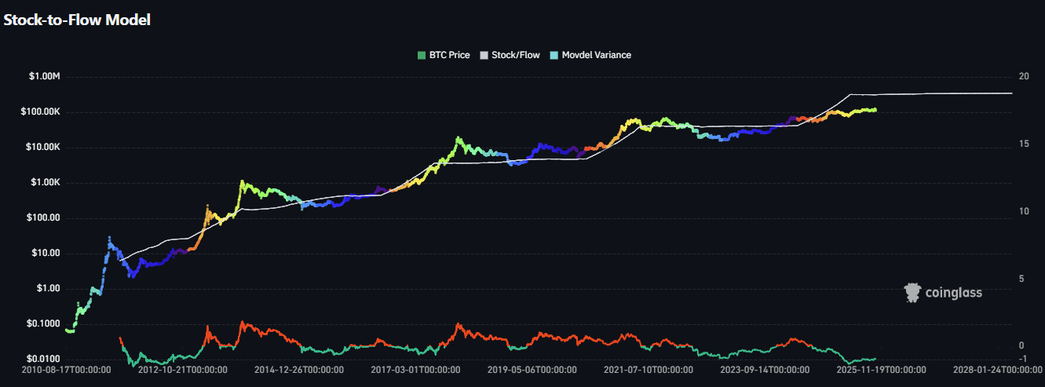
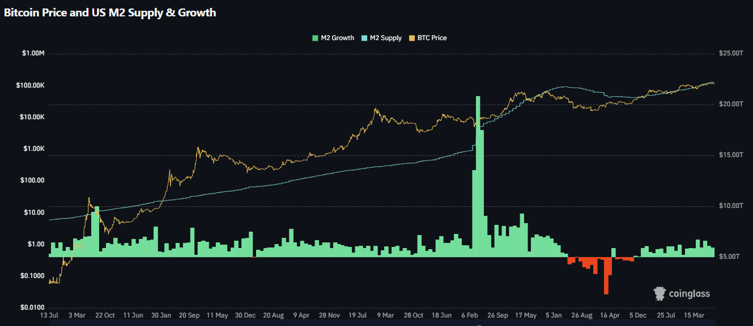
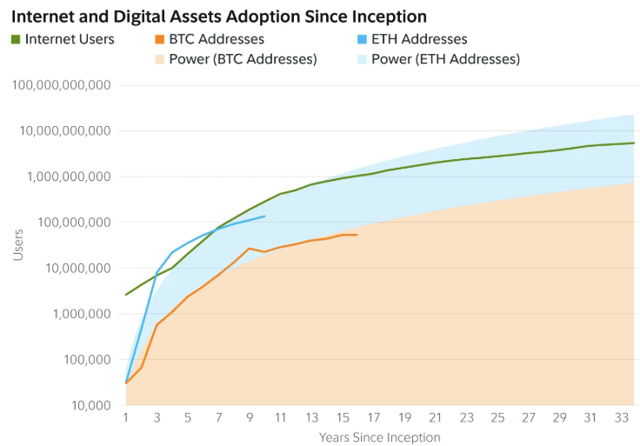
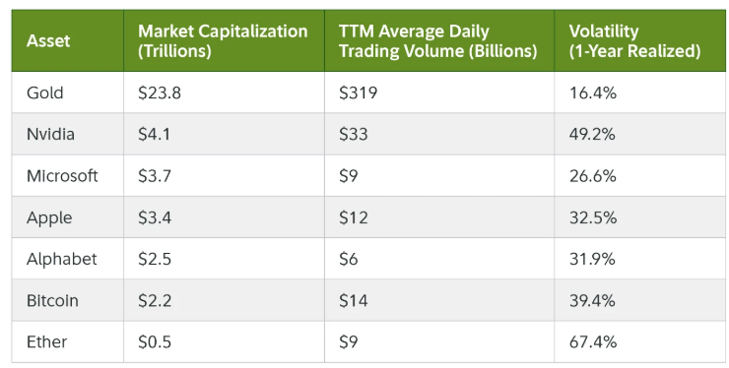
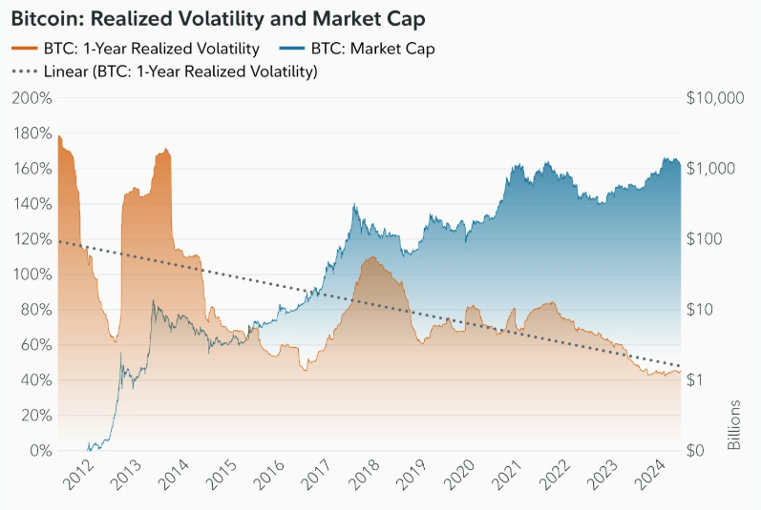
如何估值加密貨幣
資料來源：Statista、Fitch、研究報告、Dune Analytics、DappRadar。市場數據截至 2024 年 12 月 31 日
備註：(1) 2020 年至2025 年根據 Statista 和企業披露的數據。2030 年數據基於 BCG 報告。(2) 普及率計算方式為加密貨幣持有者數量除以總人口數；總人口數及預測基於 Fitch 研究。

Slide 90
淺談虛擬資產
如何安全投資加密貨幣

Slide 91
如何安全投資加密貨幣
與其他金融資產相似，投資加密貨幣可能有其風險，亦有可能造成財務虧損。為加強加密貨幣買賣的安全性，請見六大要點提示：
自行研究: DYOR 「自行研究」(do your own research) 的意思。在投資任何加密貨幣前，務必要了解區塊鏈技術的基本知識，例如加密貨幣的不同類型以及市場動態。書本、部落格、podcast 及論壇都是很好的起點。您亦應了解不同加密貨幣背後的專案、團隊及技術，方能做出明智決策。
  基本分析涉及評估整個項目資產的潛力，包括其應用、團隊、白皮書、開發、營銷、管理、聲譽、長期目標及其他因素等。
  技術分析（TA）會考慮以往的價格走勢和交易量數據，以嘗試預測未來的價格走勢，該技術通常涉及陰陽燭圖表和TA指標，例如移動平均線及趨勢線。
當心詐騙: 加密貨幣領域充滿了創新和有趣的產品，但不幸的是，它也受到各式各樣的加密貨幣詐騙困擾。切勿相信網路陌生人，並當心金字塔和龐氏騙局。如果您需要協助，請聯絡官方客服管道。當心網路釣魚、多重簽名、空投和贈獎詐騙。仔細驗證社群媒體帳戶，避免陷入冒名 (偽造) 個人檔案的圈套。考慮使用信譽良好的密碼管理器，並確保您的私鑰和助記詞處於離線狀態。您亦可拆分助記詞以提高安全性。

Slide 92
如何安全投資加密貨幣
從小額投資開始: 加密貨幣市場可能波動極大且難以預測，熱門程度較低的代幣尤然。從小額投資開始是更安全明智的做法，這樣即使發生虧損也不會傷荷包。這種方法可讓您體驗並加深了解市場趨勢，而又無需承擔太多風險。
隨時掌握最新資訊: 加密貨幣環境發展非常快速，因此隨時了解新聞、技術進步和監管更新非常重要。承擔風險前，請確保您充分了解這些產品。
選擇聲譽良好的加密貨幣交易所: 為您的加密貨幣投資選擇知名且安全的加密貨幣交易所是您的首要任務。如果幣安在您所在地區尚未提供服務，請先比較有關交易量 、手續費、客服、安全性、介面和提供的加密貨幣等不同選項。
實施風險管理: 投資任何加密貨幣之前，務必採取風險管理技巧。例如，投資你能承受損失的金額，並設定止損單限制潛在損失，便能讓結果大不相同。

Slide 93
如何安全投資加密貨幣
避免害怕錯過 (FOMO): 害怕錯過 (FOMO) 是許多交易者都有的感受。但是，這會對您的行動產生何種影響，需要慎重以待。如果害怕錯過投資機會，就會因輕率判斷而忽略限制和交易計畫。我們現在能夠透過網際網路、社交媒體及其他通訊管道存取大量資訊，因此很容易受到影響。
建立交易計畫:如果不想讓情緒干擾交易，最佳方式就是建立計畫並堅持下去。這樣一來，預期外的利得、損失、謠言或 FUD 就不會擾亂您的決定。因此，交易計畫需要有什麼內容？您的計畫必須概述想運用的交易類型、交易條件及交易目標，而風險狀況和交易風格將決定您的限制何在。您必須明確建立交易計畫，並樂意日後再追蹤自己的決定。您的交易計畫可能包括：
  定期定額投資 (DCA)：避免一次性在高點買入所有倉位。自動在固定時間投入固定金額，從而平滑購入成本，是應對波動市場的有效紀律策略。
  占總資本比例的投資金額上限 e.g. 1-10%
  投資組合的多元化程度
  停止交易的時機（時間、交易量等）
  損失上限
  交易的產品或資產
資料來源：Statista、Fitch、研究報告、Dune Analytics、DappRadar。市場數據截至 2024 年 12 月 31 日
備註：(1) 2020 年至2025 年根據 Statista 和企業披露的數據。2030 年數據基於 BCG 報告。(2) 普及率計算方式為加密貨幣持有者數量除以總人口數；總人口數及預測基於 Fitch 研究。

Slide 94
淺談虛擬資產
Web3 領域快速增長

Slide 95
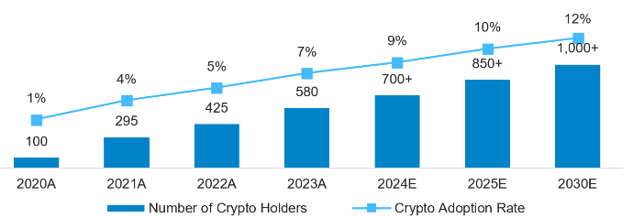
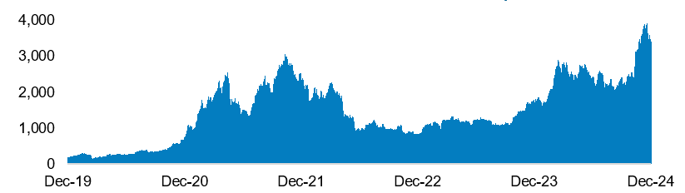
加密資產普及程度快速增長
加密貨幣持有者數與普及率⁽¹⁾
作為替代投資的主流普及程度
（百萬名）
加密市場總市值（十億美元）
自 2019 年底以來的表現：+1,638%
加密資產持有者數
普及率
機構投資者對數字資產及區塊鏈的高度信心
數字資產機構投資者的信心指標
情緒
資產配置
投資
資產代幣化
94%
67%
42%
55%
68%
62%
50%
44%
相信區塊鏈技術具有長期價值
曾經投資
數字資產或相關基金
於 2023 年增加投資
數字資產及相關產品
計劃於未來 2 至 3 年
進一步增加配置
計劃投資
比特幣 ETP
偏向透過註冊的投資工具來接觸加密貨幣，
而非現貨交易
對投資代幣化資產
感興趣
對將其資產代幣化
感興趣
資料來源：Statista、Fitch、研究報告、Dune Analytics、DappRadar。市場數據截至 2024 年 12 月 31 日
備註：(1) 2020 年至2025 年根據 Statista 和企業披露的數據。2030 年數據基於 BCG 報告。(2) 普及率計算方式為加密貨幣持有者數量除以總人口數；總人口數及預測基於 Fitch 研究。

Slide 96
加密資產- 獨特的分散風險工具
與傳統資產的低相關性
  比特幣的價格走勢與股票（如標普500）、債券等主要資產類別的相關性歷來較低。
  這意味著在市場波動時，比特幣可能呈現不同的走勢，有助於平滑投資組合的整體波動並提升風險調整後回報。
獨特的風險回報特徵
  比特幣具有高波動性，但其歷史上的高潛在回報為投資組合提供了另一種增長維度。
  將其納入一個由股票和債券組成的傳統投資組合中，有機會在相同的風險水平下提升長期預期回報。
數位化與新價值儲存模式
  比特幣視為一種新興的價值儲存工具，類似於「數位黃金」。
  其在供應量上的稀缺性（固定上限2,100萬枚）和全球可及性，使其在數位時代成為一種獨特的資產。
日益增長的機構參與度
  隨著市場基礎設施（如監管、託管服務、交易所交易產品ETP）的日益成熟，機構投資者更能安全、合規地接觸比特幣。
  這不僅提升了比特幣的流動性，也強化了其作為合法資產類別的地位。

Slide 97
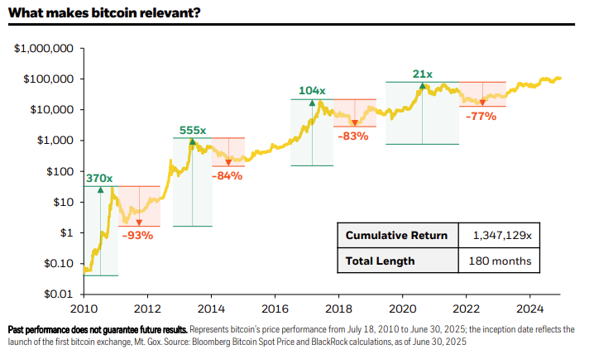
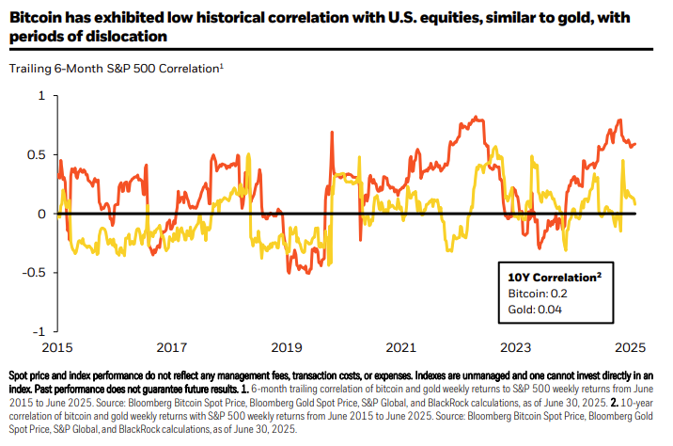
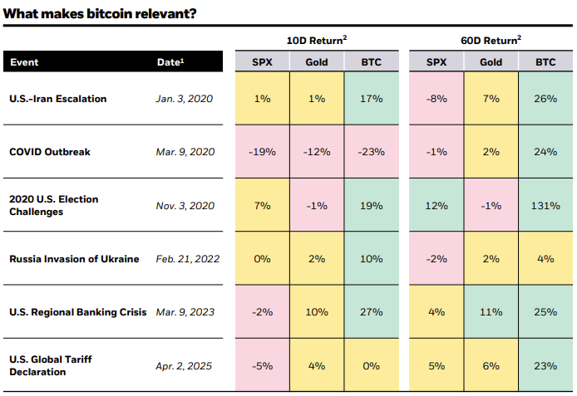
資料來源：Blackrock, Statista、Fitch、研究報告、Dune Analytics、DappRadar。市場數據截至 2024 年 12 月 31 日
備註：(1) 2020 年至2025 年根據 Statista 和企業披露的數據。2030 年數據基於 BCG 報告。(2) 普及率計算方式為加密貨幣持有者數量除以總人口數；總人口數及預測基於 Fitch 研究。

Slide 98
中長期利好因素與風險
🟦 中期展望（數月）：政策革命推動進展
1. 立法進展
OBBB（2025年7月）：美國自2017年以來最大稅法重寫
GENIUS法案（2025年7月）：首個聯邦穩定幣框架，規範1,600億美元市場（約佔加密交易60%）
CLARITY法案：兩黨眾議院通過，參議院待審 —— 明確證券與商品邊界
2. 政治支持進入中期
2026年中期選舉：加密市場關鍵拐點
Fairshake PAC：募集1.16億美元，2024年選舉勝率91%
親加密立法者：眾議院274席，參議院20席
3. 穩定幣作為流動性驅動因素
穩定幣是“全球流動性的基礎支柱”
GENIUS法案為機構提供明確性
預計穩定幣驅動的資金流入激增，或引發投機泡沫

Slide 99
中長期利好因素與風險
🟦 長期展望（數年）：行政與立法協同
1. 特朗普政府承諾
各機構強力支援加密政策
SEC主席Paul Atkins啟動“Project Crypto”
財政部長Scott Bessent推動美國為“加密超級大國”
2. 兩黨共識
“加密+反中”成為僅有的兩黨重合議題
3. 美聯儲過渡期（2026年後）
Powell任期2026年5月結束
預計新任主席更支援加密友好政策
4. 個人與機構參與
美國富豪30%擁有加密資產（據Forbes）
傳統金融強勢進入，預計加劇利益衝突風險

Slide 100
中長期利好因素與風險
🟦 超長期展望（數十年）：貨幣體系變革
1. 多極貨幣未來
美元主導地位讓位於多貨幣格局
穩定幣成為新貨幣體系關鍵基礎
大型銀行（如摩根大通）融合穩定幣解決方案
2. AI與加密協同
David Sacks任“加密與AI主管”
AI需要可程式設計貨幣，推動加密基礎設施需求
長期趨勢：AI與區塊鏈成為新經濟支柱

Slide 101
中長期利好因素與風險
🟧 主要風險與對策
1. 政治風險
中長期積極因素與風險
2. 通脹擔憂
關稅上漲，全球核心通脹（2025年下半年）預計3.4%
美聯儲高利率持續，對加密流動性構成壓力

Slide 102
淺談虛擬資產
什麼是去中心化金融 (DeFi)？

Slide 103
什麼是去中心化金融 (DeFi)？
DeFi 讓用戶只需要錢包和一些加密貨幣即可使用加密貨幣金融服務。去中心化應用程式 (DApp) 在多個區塊鏈上提供借貸、流動性供應、交換交易、質押等功能。
雖然以太坊是 DeFi 的發源地，但目前大多數具智能合約功能的區塊鏈皆有 DeFi DApp 運行，包括 Arbitrum 和 Optimism 等第 2 層解決方案。智能合約對於 DeFi 所提供的服務極為重要，這些服務包括質押、投資、借貸、收成等。
DeFi 讓人們可以優化收益、參與去中心化市場、使用銀行服務以及進行快速借貸。然而 DeFi 並非毫無風險；在承擔風險之前，請務必進行仔細的研究。

Slide 104
DeFi 的主要優勢
傳統金融依賴不同機構才能運作（例如：銀行作為中介機構、法院提供仲裁）。DeFi 應用程式不需要任何中介或仲裁機構。程式碼規定了每一種潛在爭議的解決方案，用戶由始至終均能掌控其資金。這種自動化降低了成本，使金融體系更為順暢。
均部署於區塊鏈上，因此消除了單點故障的可能性。資料被記錄在區塊鏈上，並散佈於數以千計的節點，使得審查或潛在服務關閉變成一項複雜的工作。
這種開放生態系的另一項主要優勢，是個人能輕鬆存取服務，對未能接觸其他金融服務的個人來說非常便利。由於傳統金融系統依賴中介機構謀利，在低收入社區難以見其蹤影。然而，DeFi 讓相關成本得以大幅降低，而低收入人士亦能受惠於更為廣泛的金融服務。

Slide 105
DeFi 的風險
交易對手風險: 如果您參與質押借幣或任何其他類型的借貸，您可能面臨交易對手未償還債務的風險。
監管風險: 某些服務和專案的合法性可能難以確定。如果您投資的智能合約因監管問題遭到關閉，那麼您的資金可能面臨風險。全球監管機構近期的行動和指導方針，正在影響 DeFi 的發展和採用。
代幣風險: 您持有的資產受其流動性、可信度、代幣智能合約安全性以及相關專案和團隊的影響，其風險水準各不相同。由於 DeFi 領域有許多低市值代幣，因此代幣風險可能特別高。
軟體風險: 您所投資的智能合約，其安全性可能會因程式碼漏洞而遭受損害。由於您的錢包連結到 DeFi DApp 並給予其某些權限，也可能受到威脅。為了應對這些風險，多重簽章錢包和風險保障基金等安全措施也應運而生。
無常損失: 如果您在流動性礦池進行質押，價格偏離您所輸入的價格比率將導致您在提領時損失一部份存入礦池中的代幣。

Slide 106
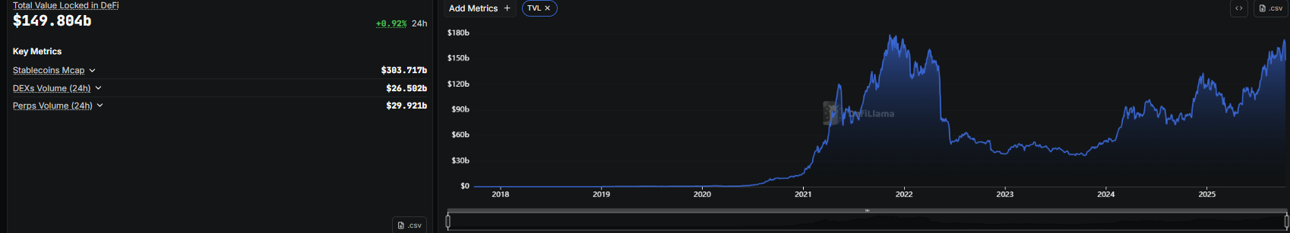
資料來源：Statista、Fitch、研究報告、Dune Analytics、DappRadar。市場數據截至 2024 年 12 月 31 日
備註：(1) 2020 年至2025 年根據 Statista 和企業披露的數據。2030 年數據基於 BCG 報告。(2) 普及率計算方式為加密貨幣持有者數量除以總人口數；總人口數及預測基於 Fitch 研究。

Slide 107
淺談虛擬資產
什麼是穩定幣？

Slide 108
什麼是穩定幣？
定義 ：穩定幣是一種旨在維持與法定貨幣（或其他參考資產，如黃金）匯率價值穩定的數字資產; 目前市面上絕大多數的穩定幣錨定的資產為美元。
補充說明：穩定幣雖涵蓋多種新型支持機制（如演算法對沖+加密資產抵押），但在主流討論與監管框架中，穩定幣特指至少以1：1比例、由同幣種法定資產組合支援的類型（例如 USDT、USDC）。

Slide 109





港元《法幣抵押型穩定幣》鑄造流程概括示意圖
轉法幣港元到發行方
發行方
（受監管/持牌機構）
買家
將收到的法幣存入儲備資產中
發行方確認收到法幣港元後，向HKD穩定幣平臺提交鑄造請求（將通過一系列的管理流程）
發行+贖回平臺
發行
HKD 穩定幣被鑄造然後轉入買家的錢包
贖回
流通中HKD穩定幣將由儲備資產中的法幣現金及其他高流動性資產做為價值錨定/支撐
運作後台
存儲/外匯管理
發行人的核心職責之一，是確保儲備資產對「已發行穩定幣」提供至少 1：1 的全額抵押支援

Slide 110
為何選擇穩定幣？ 相較支付寶、微信支付或八達通卡有何優勢？
歷史上貨幣形態的演進，始終圍繞三大核心目標：
  更高實用性，
  更廣泛相容性
  更低摩擦成本（提升易用性與流動性）;
穩定幣作為貨幣演進的下一階段，本質是對此進程的延續與深化。
若僅比較特定場景，穩定幣未必優於現有支付工具; 但此解讀方式實則誤判其核心價值——正如2010年代電子錢包的普及歷程所示：關鍵不在單一功能替代，而在於重構價值流通的底層範式

Slide 111



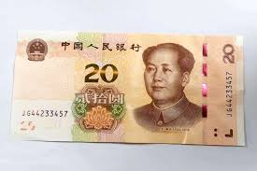

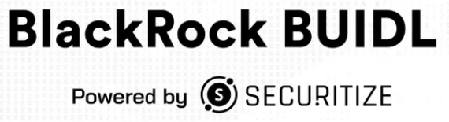





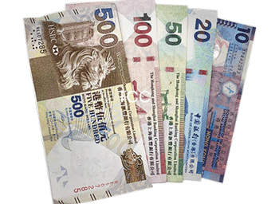
回顧2010年代初：當八達通已廣泛覆蓋，為何仍需電子錢包？ （此疑問與當下很多對穩定幣的質疑如出一轍）
我們認為通證化貨幣（穩定幣）將帶來更具意義的變革
代幣化貨幣
1/ 電商崛起與線上消費的巨浪——推動電子錢包/數位支付成為必然
2/ 消費者行為變革催生新功能與價值（如：電子紅包等創新場景）
3/ 巨集觀趨勢驅動：數位化浪潮深化 + 地域特殊性因素（例：中國假鈔泛濫問題）
1）金融產品與基礎設施的代幣化巨浪——穩定幣成為必然的結算層
電子支付
持續共存
2）消費與企業產品日益自動化（代碼驅動）且複雜化，唯有採用同標準可程式設計貨幣方能支撐此進程
實體
（電子現金）
持續共存（但使用率 / 滲透率持續演變）
實體紙張現金
3）開放生態系統轉向（驅動力：用戶體驗升級、反壟斷需求、加速創新）與互作性標準構建
持續共存（但使用率/滲透率持續演變）
Pre-2000s
2000s
2010s
2020s

Slide 112
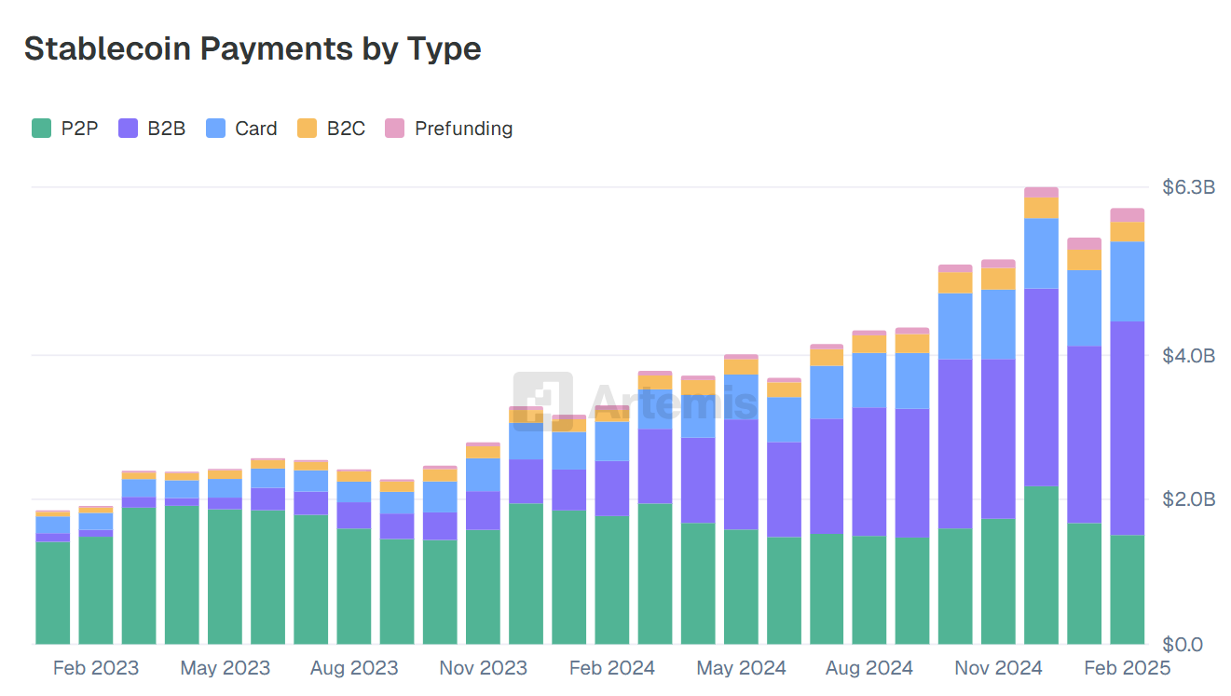
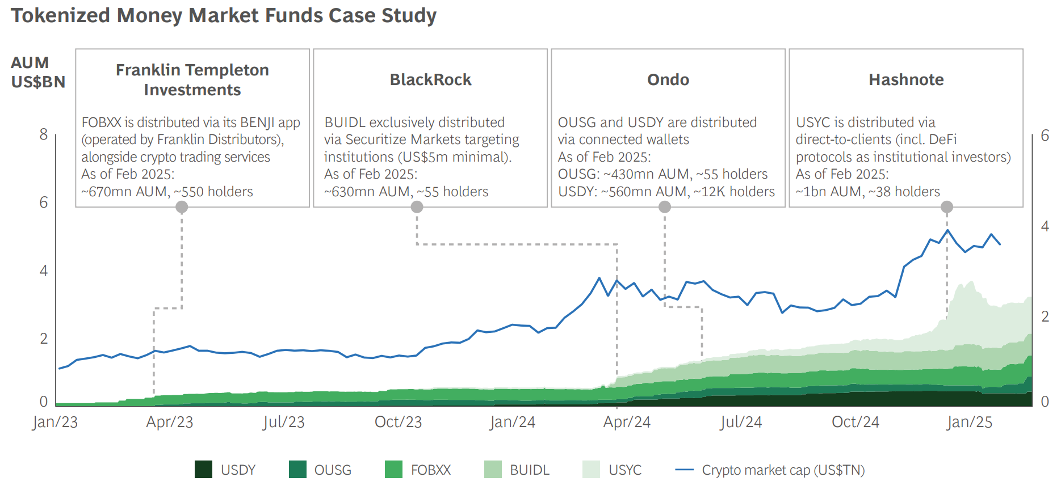
交易以外的現實世界應用場景正在崛起
2024年近2萬億美元穩定幣交易量已源自實體經濟早期應用（含支付結算及代幣化貨幣市場基金）; 隨著配套基建、監管框架及市場接受度持續成熟，穩定幣在多元場景的大規模應用浪潮即將來臨
1
2
企業間B2B的月支付額突破30億美元（較6個月前增長1.5x）
貝萊德BUIDL基金自2024年4月推出後，代幣化貨幣基金資產管理規模（AUM）已擴大10倍，當前超20億美元
我們在這：現行發展階段，受監管的代幣化貨幣/穩定幣正成為開啟代幣化金融大規模應用的基石
企業間支付
全天候流動性
外匯交易
可程式設計支付與自動化AI Agent
貨幣市場基金
其他代幣化現實世界資產（私募基金、債券、信貸、股票等）
法幣出入金通道
跨境結算
新型金融服（小額投資、超個人化服務）
及其他開放性可能...
加密貨幣交易
P2P支付
現金流管理
即時抵押品
規模化應用的演進路徑示意圖

Slide 113
穩定幣與央行數碼貨幣及代幣化存款具互補功能：
既是現行市場基建工具，更是中長期發展的核心支柱
 | 持牌穩定幣（持牌穩定幣） | 央行數碼貨幣 （CBDC） | 代幣化存款 （Tokenized Deposits）
發行主體 | 發行機構 + 儲備資產 | 中央银行 | 商業銀行
區塊鏈網路 | 公有區塊鏈（可相容私有鏈） | 私有區塊鏈 | 私有區塊鏈
現狀 | 當前最活躍的代幣化貨幣（流通量>2,500億美元） 全球金融市場地位日益明確 美元穩定幣主導，但合規機構推動本地貨幣應用 | 全球進展緩慢，多處概念驗證階段（涉及隱私合規挑戰、技術操作風險、監管框架適配、貨幣供應調控等多維議題） 中國與香港為主要推動者 美國（川普政府）已立法禁止 | 多家銀行開展概念驗證 資金管理功能獲驗證 實際應用進展遲緩
優勢 | 商業模式及應用場景成熟 全民可及性，網路效應潛力最大 儲備資產受監管審計 | 央行背書的法定代幣化貨幣 央行信用風險 | 可向持有者支付利息 商業銀行信用風險
劣势 | 法規禁止支付利息 私營發行機構風險 | 需跨政府協作建立全球網路 網路攻擊可能導致整個貨幣系統的癱瘓 | 局限於銀行同業生態，網路效應有限 因交易對手信用風險導致非標準化（如小型銀行存款）
地区 | 全球（香港/美国/欧盟/新加坡/阿联酋/日本/瑞士领先监管） | 中國/東南亞/中東 | 全球
香港舉措 | 《穩定幣法案》2025年8月實施 | 「多邊央行數碼橋」（mBridge） | 「集結計劃」（Project Ensemble）
當前美元發行商壟斷著99%市場佔有率，由Tether/Circle主導

Slide 114
香港穩定幣發展概覽與時程表
概覽
預期時程表
（部分為非正式官宣的資訊）
渣打銀行（香港）、Animoca Brands及 HKT（香港電訊）組成的合資企業
現階段：已進入香港金融管理局（HKMA）的「穩定幣發行人監管沙箱」（該合資企業為三家參與機構之一）
進展：除監管許可申請外，公司組建、辦公場地、品牌籌備等行政工作亦順利推進
6/7月
《穩定幣法案》獲立法會通過並刊憲
8月
《穩定幣條例》正式生效，金管局開始接受發行人牌照申請
《香港穩定幣法案》核心要點
僅允許 法幣掛鉤型穩定幣（演演算法穩定幣或合成資產支援模式不適用於持牌機構）
支援多幣種穩定幣（儲備資產需與掛鉤貨幣一致），但港元穩定幣可例外的以美元資產（如美國國債）作為儲備
明確定義穩定幣的非證券性質，允許零售使用者直接使用（包括非託管錢包）
目前禁止內生收益機制（即穩定幣本身不可產生利息）
Q3-4
完成牌照申請程式
Q4 2025 - Q1 2026?
取得牌照+首階段上線，聚焦機構分銷管道，開放零售應用場景（主要確保運營與風險管理系統穩健）

Slide 115
實體資產代幣化 (Real World Assets Tokenization)
將現實世界資產（如房地產、藝術品、基金份額）轉化為區塊鏈上的數字代幣。這能提高流動性、降低交易門檻並增加透明度。這是傳統金融正在積極擁抱的方向。
代幣化RWA年初至今保持強勁增長：鏈上RWA市場規模已增長至248億美元（同比增長57.9%），獲得了BlackRock（如SPiCE VC）等機構巨頭的認可。 儘管私人信貸仍佔主導地位，但當前市場只是約400萬億美元“藍天”可尋址資產類別市場的一小部分，為未來增長釋放了巨大空間。
私人信貸與美國國債佔主導地位：目前鏈上市場主要由兩類資產主導：傳統金融（TradeFi）私人信貸與美國國債（66億美元）。 這一增長不僅體現在極低的現實世界機構級違約率（0.1%），同時代幣化的私人信貸（約151億美元）正推動DeFi向市場流動性較低的一端延伸，併為DeFi提供了一個鏈上已有價值的預設無抵押資產類別。
生態系統由便利性定義：RWA生態呈現動態格局，參與者包括BlackRock、Apollo、Franklin Templeton等機構，正在探索以區塊鏈作為新分發管道、後台流程與資產代幣化平臺（如Securitize）為代表的合規市場與平臺，以及Maple Finance等原生DeFi協定。 在這些傳統參與者之外，也有公開協定並存。

Slide 116
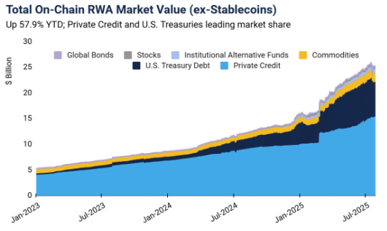
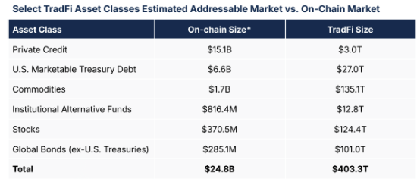
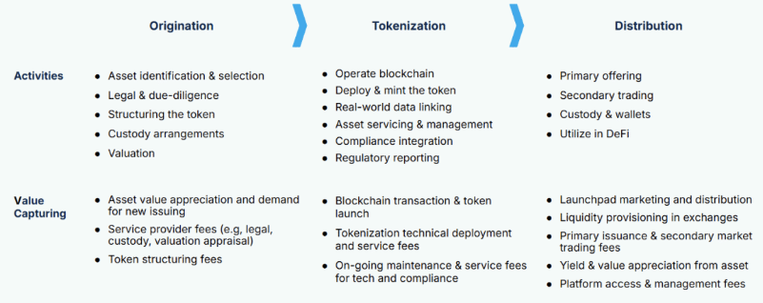

Slide 117
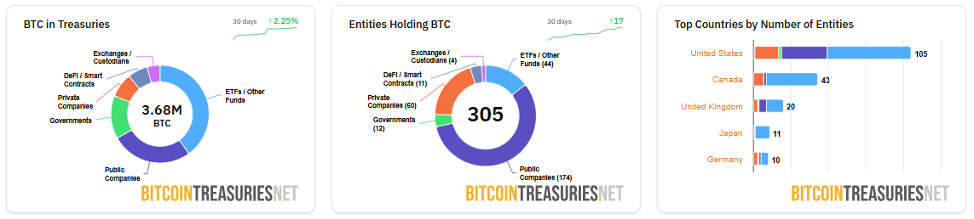
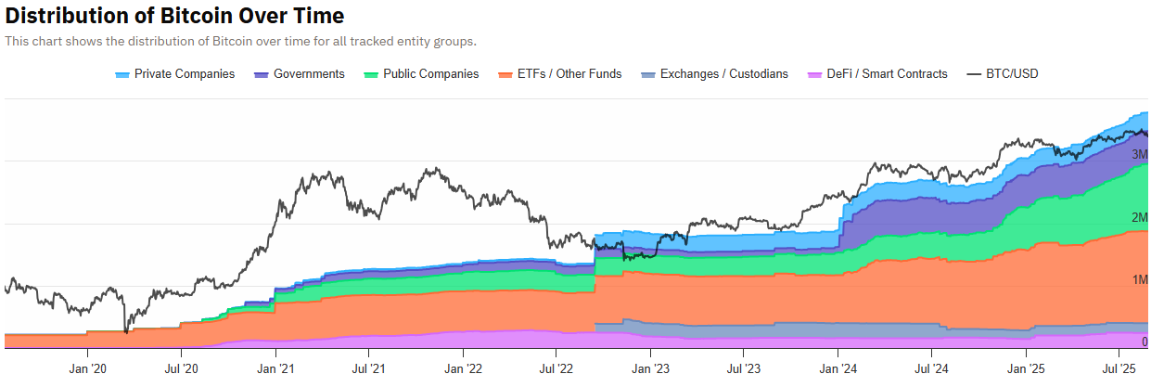
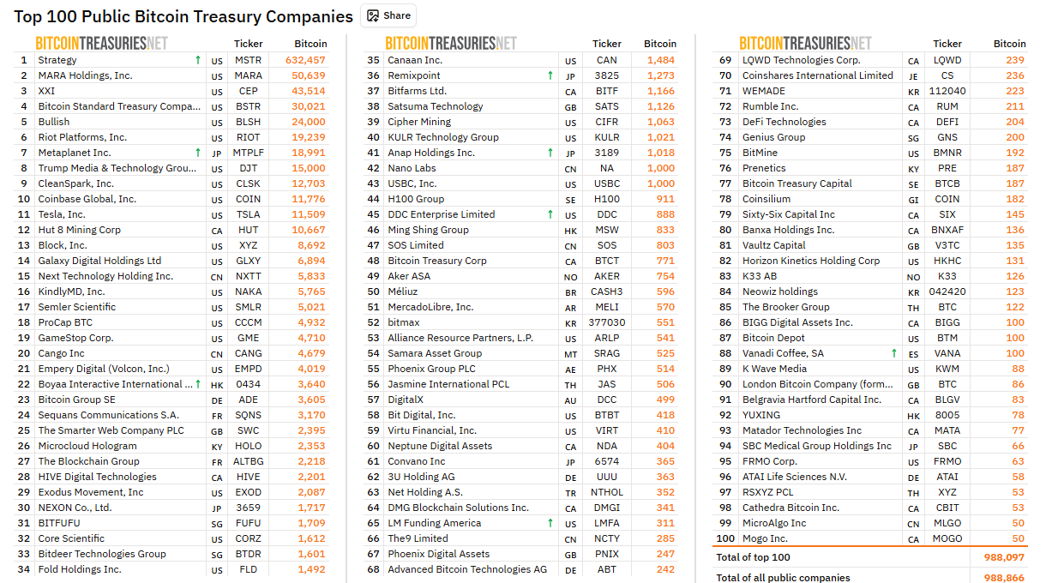

數碼資產庫存公司 (Digital Asset Treasury)

Slide 118
Microstrategy 的新$STRC優先股票結構
比特幣背書的機構級收益產品
採用可變利率A系列永久優先股架構，但具備合成穩定幣特性：專為低波動性、彈性贖回及高收益設計。提供9%起始年化收益率、未支付股息按月複利累計、101美元面值加計應計股息的全額贖回權、動態定價機制錨定100美元基準、以及維持價格重力的每日浮動清算優先權。
相比大宗商品形態的比特幣，權益/信託形態可承接30倍資本
逾100兆美元機構資本中，97%受託管理於權益(35兆)/信託(60兆)領域，大宗商品僅佔3兆——資本容量差距達30倍。即便僅有7兆貨幣市場基金的5%流入本策略，經由策略資產負債表導入比特幣的資金將超3500億美元，推動BTC突破14萬美元。
配置者的決策基準
選擇4.25%美國國債/貨幣基金？購入低風險公司債？抑或配置於比特幣背書、低波動設計的9%收益工具？核心議題已非「比特幣是否高風險」，而是「配置者還能合理化多少法幣曝險」。
演算法穩定幣飛輪機制
策略方可按101美元加計應計/未付股息贖回STRC股份；當流通量低於閾值時可啟動全額贖回權。策略利用STRC發行收益對比特幣進行定期定投，高收益特性持續吸引信貸市場資金。當BTC暴漲時贖回股份實現收益，循環重啟此運作週期。

Slide 119
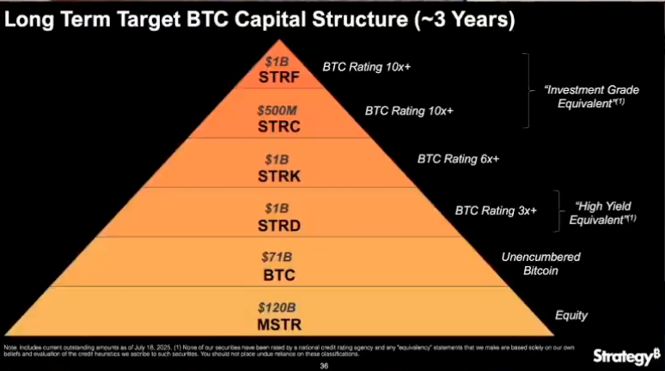
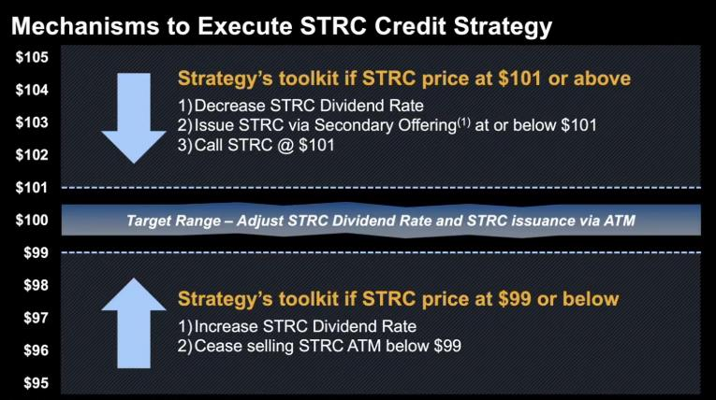
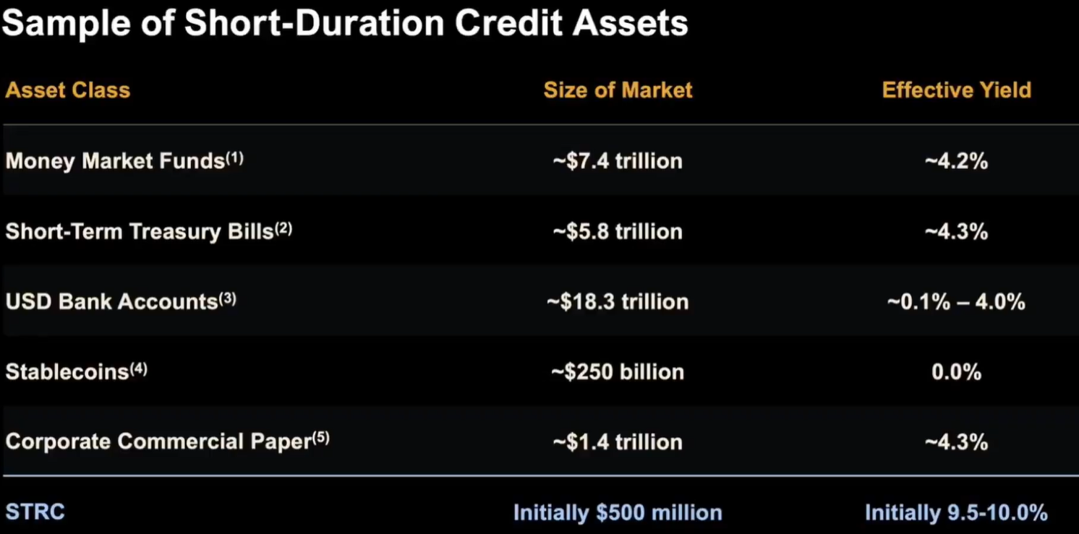
Strategy – creating a Bitcoin “Yield Curve”

Slide 120
謝謝
免責聲明
本演示文稿僅供參考，內容不構成任何形式的投資建議、財務建議或購買、出售證券的要約或邀請。 投資涉及風險，投資者應根據自身的風險承受能力和財務狀況，獨立做出投資決策。 本演示文稿中的資訊、觀點及預測僅代表資料發佈時之觀點，可能隨時更改，且不保證其準確性、完整性或及時性。
本演示文稿及其內容不應被視為對任何個人或實體的具體投資建議。 本公司及相關方不對因使用或依賴本演示文稿中的任何資訊而引致的任何直接、間接或因果性損失承擔任何責任。 投資者應自行承擔所有投資風險和損失。
使用本演示文稿的個人或機構，視為已同意以上免責聲明並放棄追究任何相關責任的權利。

